Slide 1
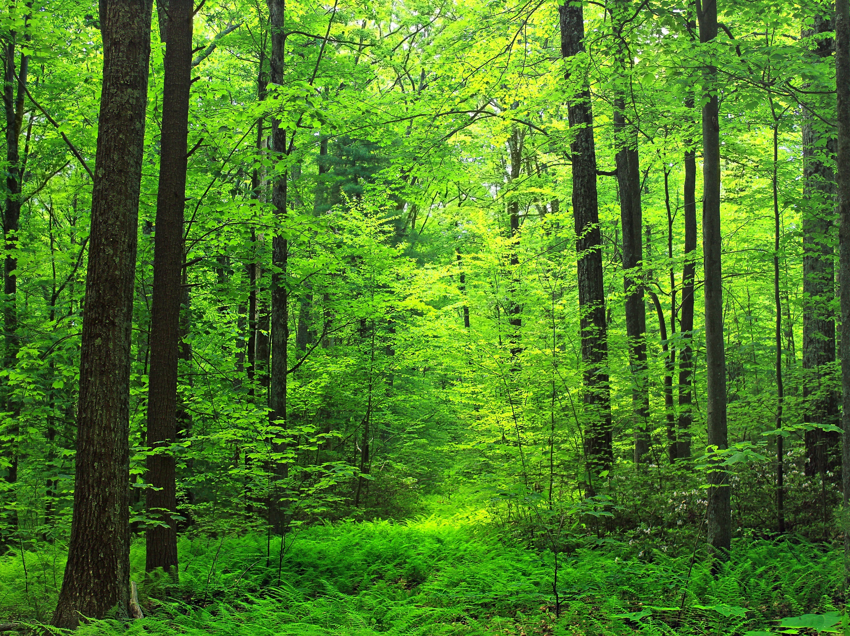
Advent Calendar 2025
Trees of the Bible

Slide 2
The trees and bushes mentioned in the bible are not the only ones to be found in the Holy Land, and not all of those mentioned are included here. Many you will recognise. You will note that there are no other plants. That is because they had a calendar of their own last year.
Select ‘Slide Show’ and ‘From Current Slide’. Pick today’s date on the grid to see what today’s tree or bush is. The Bible references are based mainly on the Authorised Version, more recent translations sometimes give the tree or bush a different name, depending on the translation from the original.
When you have finished select ‘Back to Grid’ before you shut down, ready for tomorrow.

Slide 3
1
2
3
4
5
6
7
8
9
10
11
12
13
14
15
16
17
18
19
20
21
22
23
24

Slide 4
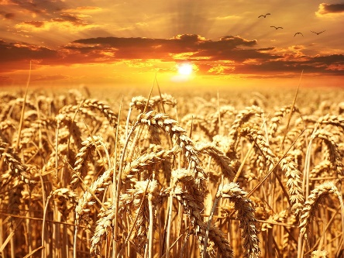
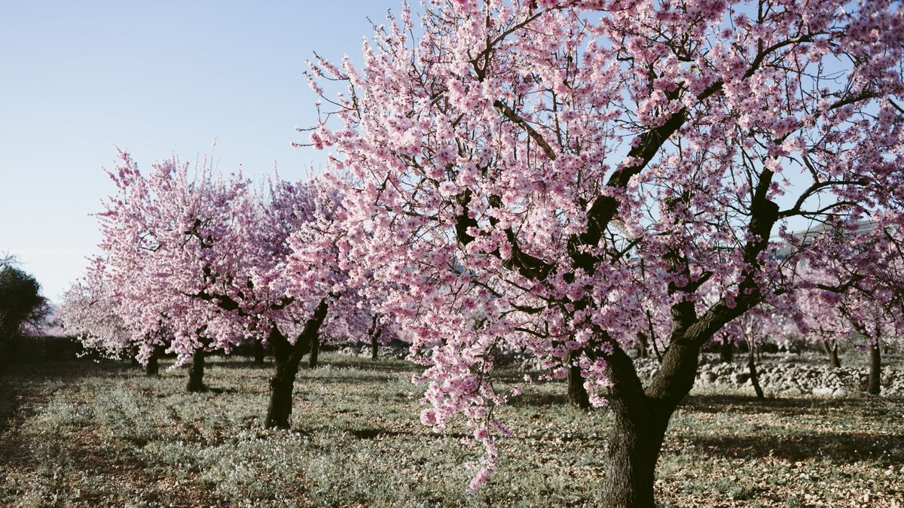
Almond Tree Genesis 43:11
After Jacob and his family had settled in Egypt during the 7 years of famine almonds were one of the “choice fruits of the land” that Joseph’s brothers took with them when they went to buy more grain as a present for “the man” selling it, who they didn’t realise was their own brother, Joseph.
Were these almonds some they had brought with them, were they some stored up from the years of plenty, or did the trees survive the famine? We will never know.
BACK TO GRID

Slide 5
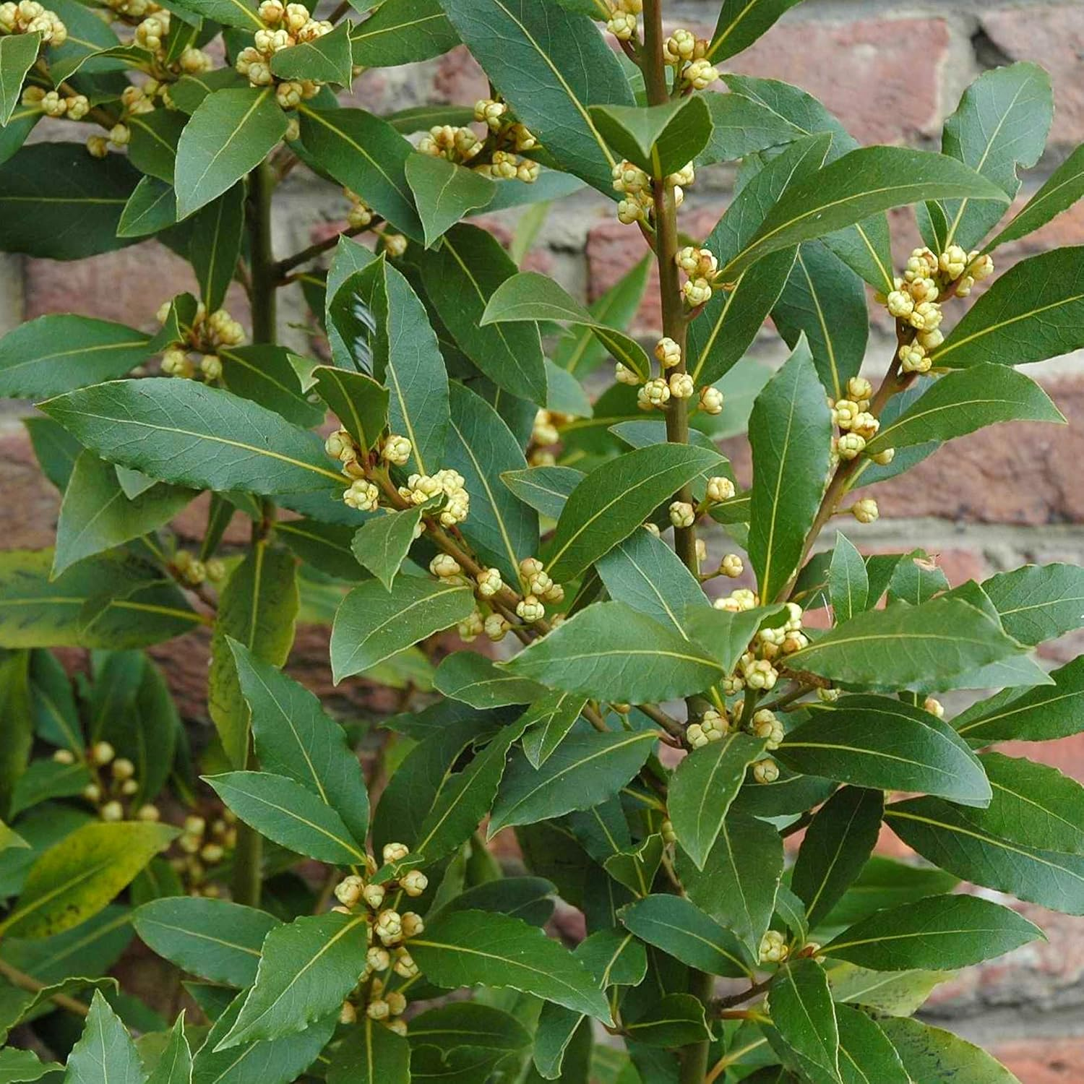
Back to grid
Bay Tree
Psalm 37:35
In biblical times the bay tree symbolised prosperity and strength. Spiritually it is associated with wisdom, protection and purification, and to the Ancient Greeks it meant courage and strength, often associated with the gods, who wore wreaths of bay. We are more used to the use of its aromatic leaves in cooking, and doubtless Mary would have known it for this too.
The psalmist likens wicked men who have got into great power to the spread of a great green bay tree. No doubt he had a few people in mind with this description. Could this apply to anyone today?

Slide 6
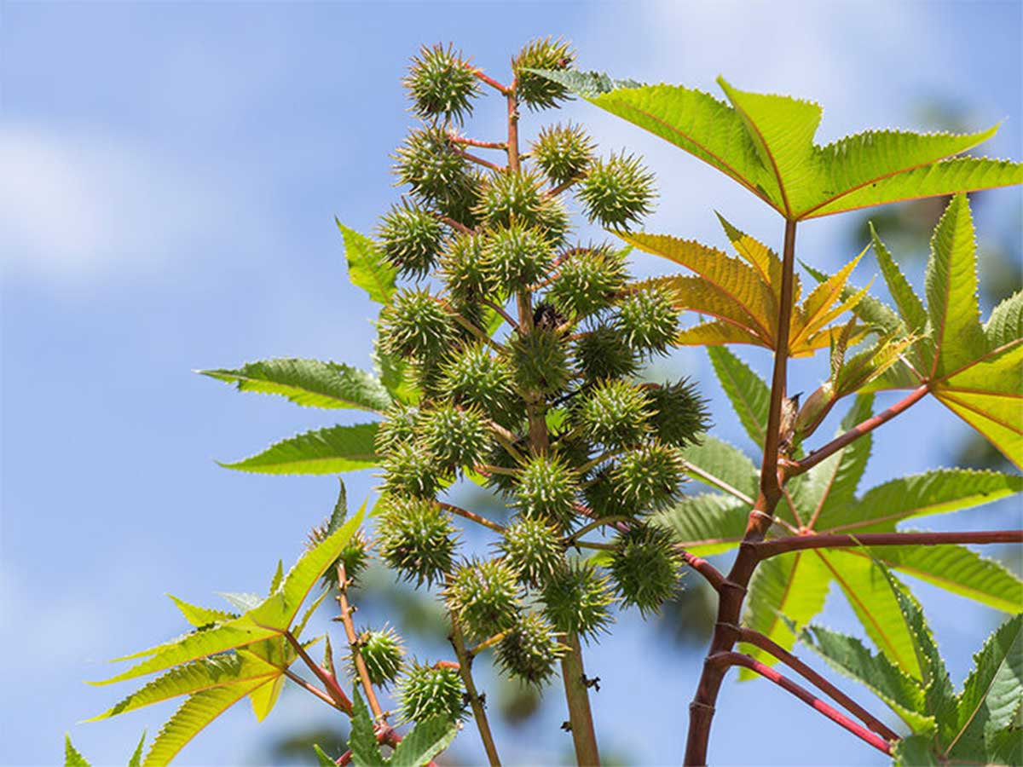
Castor Oil Tree
Jonah 4: 6-9
Generally believed to be the “gourd” tree that grew overnight, gave Jonah shade, and then died so that there was no shade. Modern translations just refer to “a bush” without giving more detail. The oil is obtained from the beans the tree produces
Back to grid
This Photo by Unknown Author is licensed under CC BY-NC

Slide 7
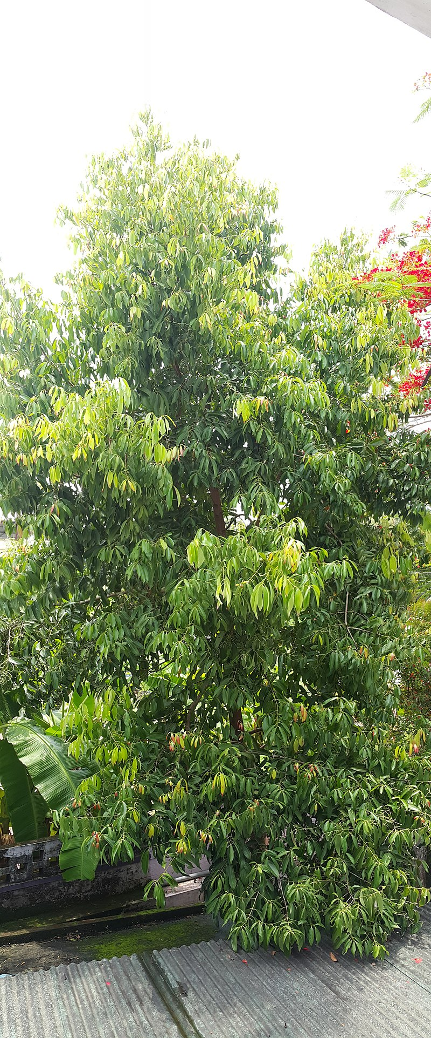
Back to grid
Cinnamon
Proverbs 7:17
The spice Cinnamon comes from the inner bark of several tree species of the genus Cinnamomum, and today is used in cooking, either as a stick of the bark or ground into a powder. It has been known since remote antiquity and was imported into ancient Egypt as early as 2000 BC where it was used in the mumification process, amongst other things. It was regarded as a gift suitable for a monarch or even a deity and was very expensive. In Roman times 327 grams cost the equivalent of 50 months’ wages for a labourer. From this text it would also appear to have been used as part of a mix of perfumes, presumably in the ground up form.

Slide 8
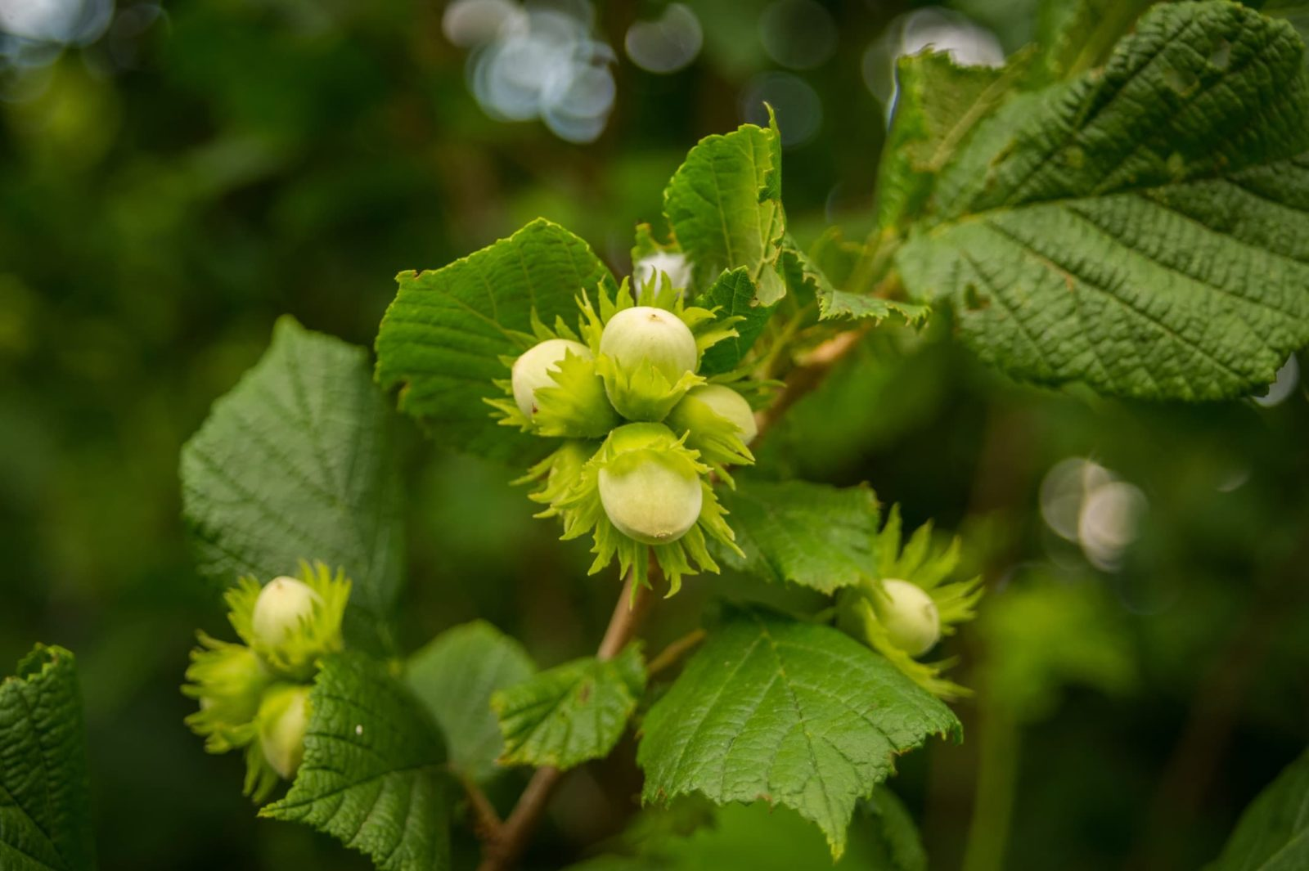
Back to grid
Hazel
Genesis 30:37-39
We know the Hazel tree or bush for its catkins in Spring and nuts in Autumn. Its wood is known for strength and flexibility. For generations it has been used to make wattle fences and hurdles to control herds and, in past centuries, the wattles that formed a basis for wattle and (mud) daub walls in simple houses common where stone was not easily available.
We are told that Jacob used Poplar and Hazel rods to put in the line of sight of sheep and goats to encourage them to produce marked offspring (see Poplar on Day 12)
.

Slide 9
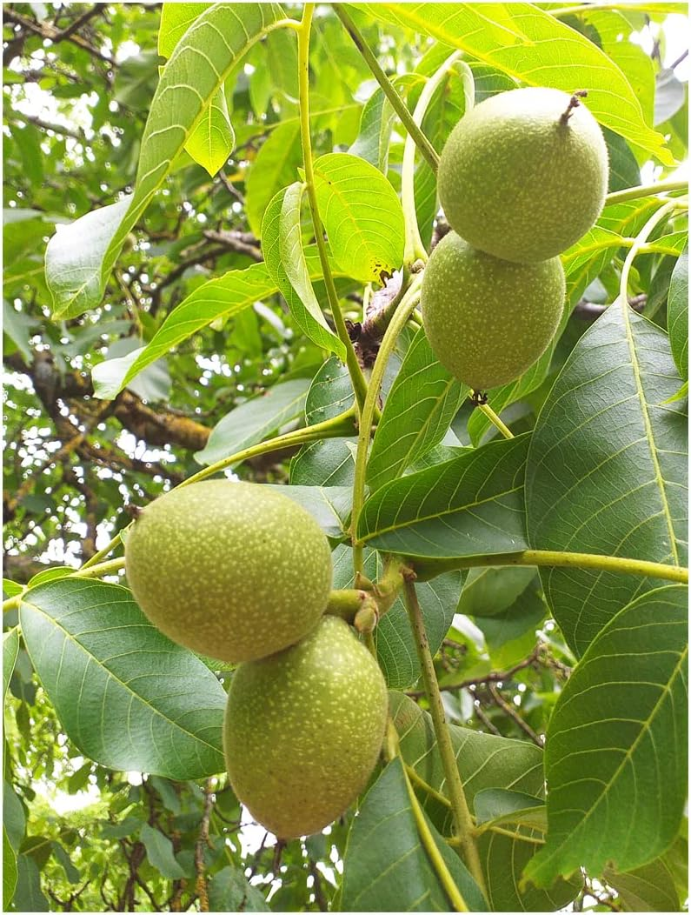
Back to grid
Walnut Tree
Genesis 43:11; Song of Solomon 6:11
These texts refer to ‘nuts’, which are generally believed to include walnuts. Walnut trees are native to a wide area stretching from The Balkans to China. The first historical account of walnut cultivation comes from Babylon (now Iraq) circa 2000 B.C. However, archaeological excavation of Neolithic sites in southwest France has uncovered roasted walnut shells, indicating walnuts were being eaten in Europe at least 8000 years ago.

Slide 10
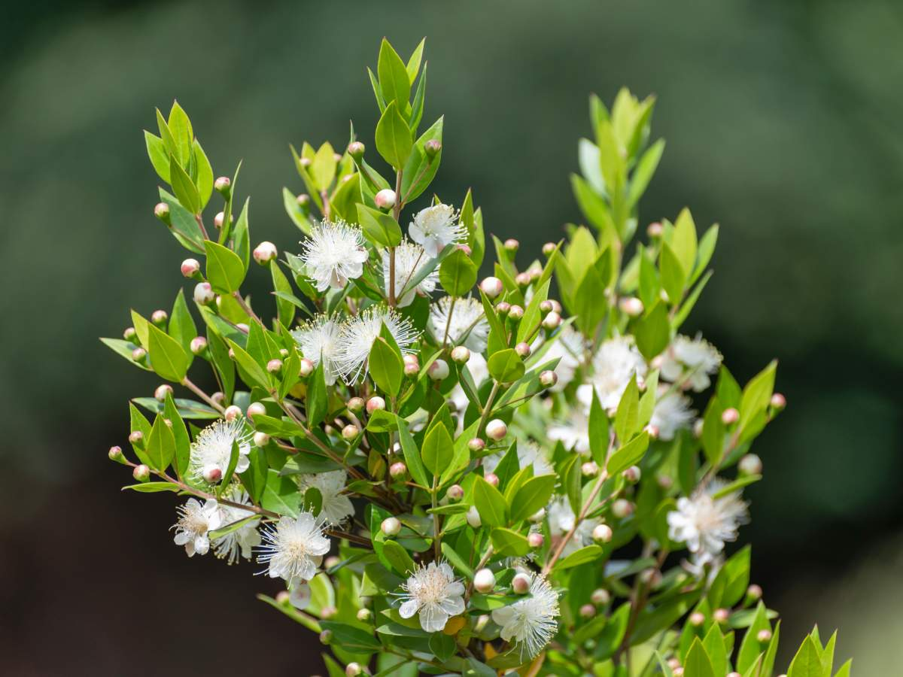
Back to grid
Myrtle
Isaiah 41: 19, 55:13; Zechariah 1:8-11; Nehemiah 8:15
The myrtle tree is often associated with beauty and the blessings of God. Thriving in arid conditions, it symbolises God’s promise to restore and revitalise His People and their land. Its modest stature emphasises humility whilst its inclusion in prophetic visions indicates the hope of God’s Promise. Its evergreen nature signifies enduring peace and God’s favour.

Slide 11
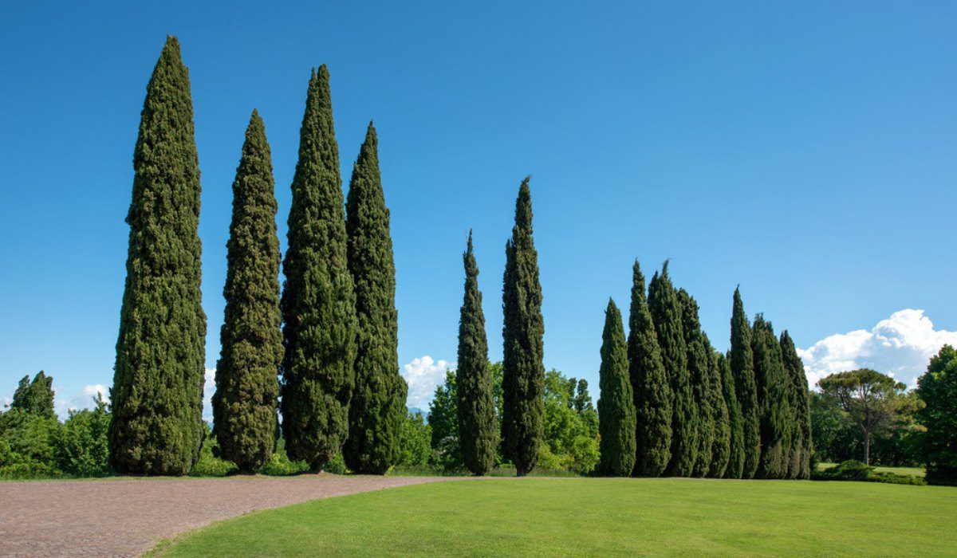
Back to grid
Cypress
Isaiah 44:14
Cypress trees belong to the genus Cupressus, and are known for their longevity, unique adaptations, and ecological importance, with some species living over 1,000 years. In Greek mythology it emerged as a symbol of mourning, sadness and loss, and thus became one of the symbols of Hades. Consequently, it has been planted in cemeteries since the classical era.
In the Bible it symbolises strength, endurance and eternal life

Slide 12
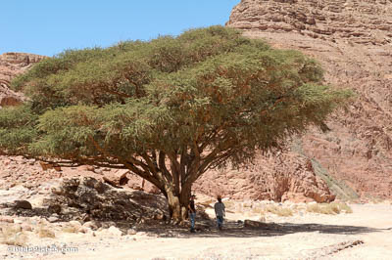
Acacia
Exodus 25:10
The Acacia Tree holds significant biblical importance, symbolising strength, resilience and the divine presence of God, particularly in the construction of sacred objects. In the Authorised Version God instructed that an ark should be made of ‘shittim wood’ to hold the testimony or covenant that He would give to the Children of Israel, and where He would meet Moses. The Revised Standard Version translates the Hebrew as acacia wood. The design specification of the ark is very detailed, both in terms of materials and dimensions, and how it would all fit together. You could build a replica today from the instructions. The first ‘flat-pack’?
Back to grid

Slide 13
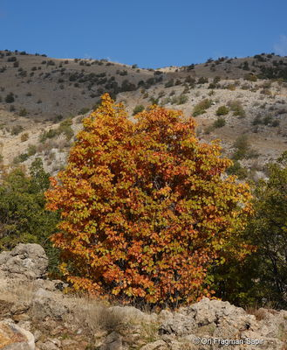
Pistachio Genesis 43:11; Song of Solomon 6:11
Pistachios are mentioned in the Bible in Genesis, although some translations simply refer to them as ‘nuts’. They are listed among the choice products of the land of Canaan, highlighting their value and significance in ancient agricultural society. Their mention, though brief, shows both the material blessings of Canaan and the importance of agricultural products in trade and diplomacy during biblical times, probably before the advent of coinage. Today, pistachios continue to be a valued crop, reminding us of their rich historical and cultural heritage.
Back to grid

Slide 14
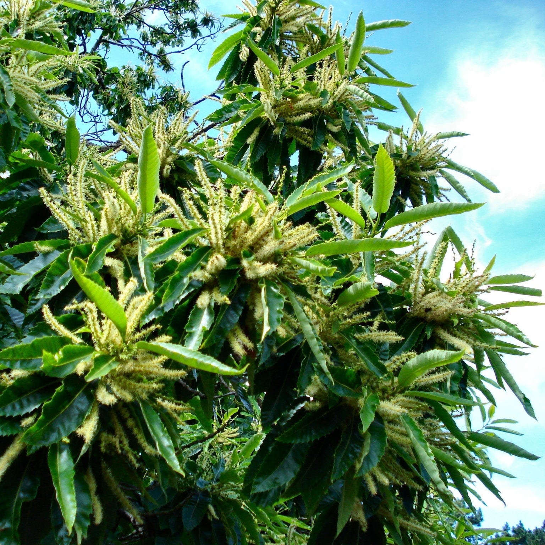
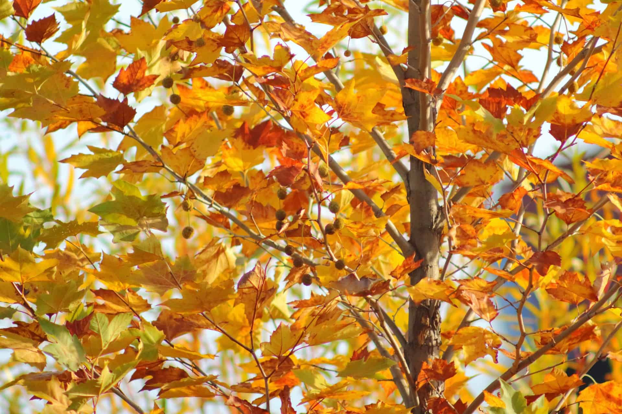
Chestnut Tree or Plane Tree
Genesis 30:37; Ezekiel 31:8
One wonders what sort of tree the original writers were referring to. The Authorised Version translates the Hebrew as ‘Chestnut Tree’; the Revised Standard Version translates it as ‘Plane Tree’. The Sweet Chestnut Tree is a native of Mediterranean countries and Asia Minor, and its reference may show the agricultural practices and natural resources of the peoples of that time. We are used to the London Plane Tree, which may be different from the Plane Tree of ancient Pelestine, which was valued for its shade. Both trees have broad leaves, although quite differently shaped
Sweet Chestnut Tree
Plane Tree
Back to grid

Slide 15
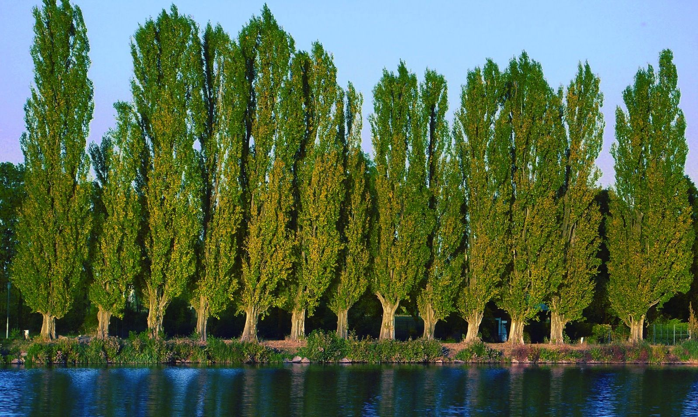
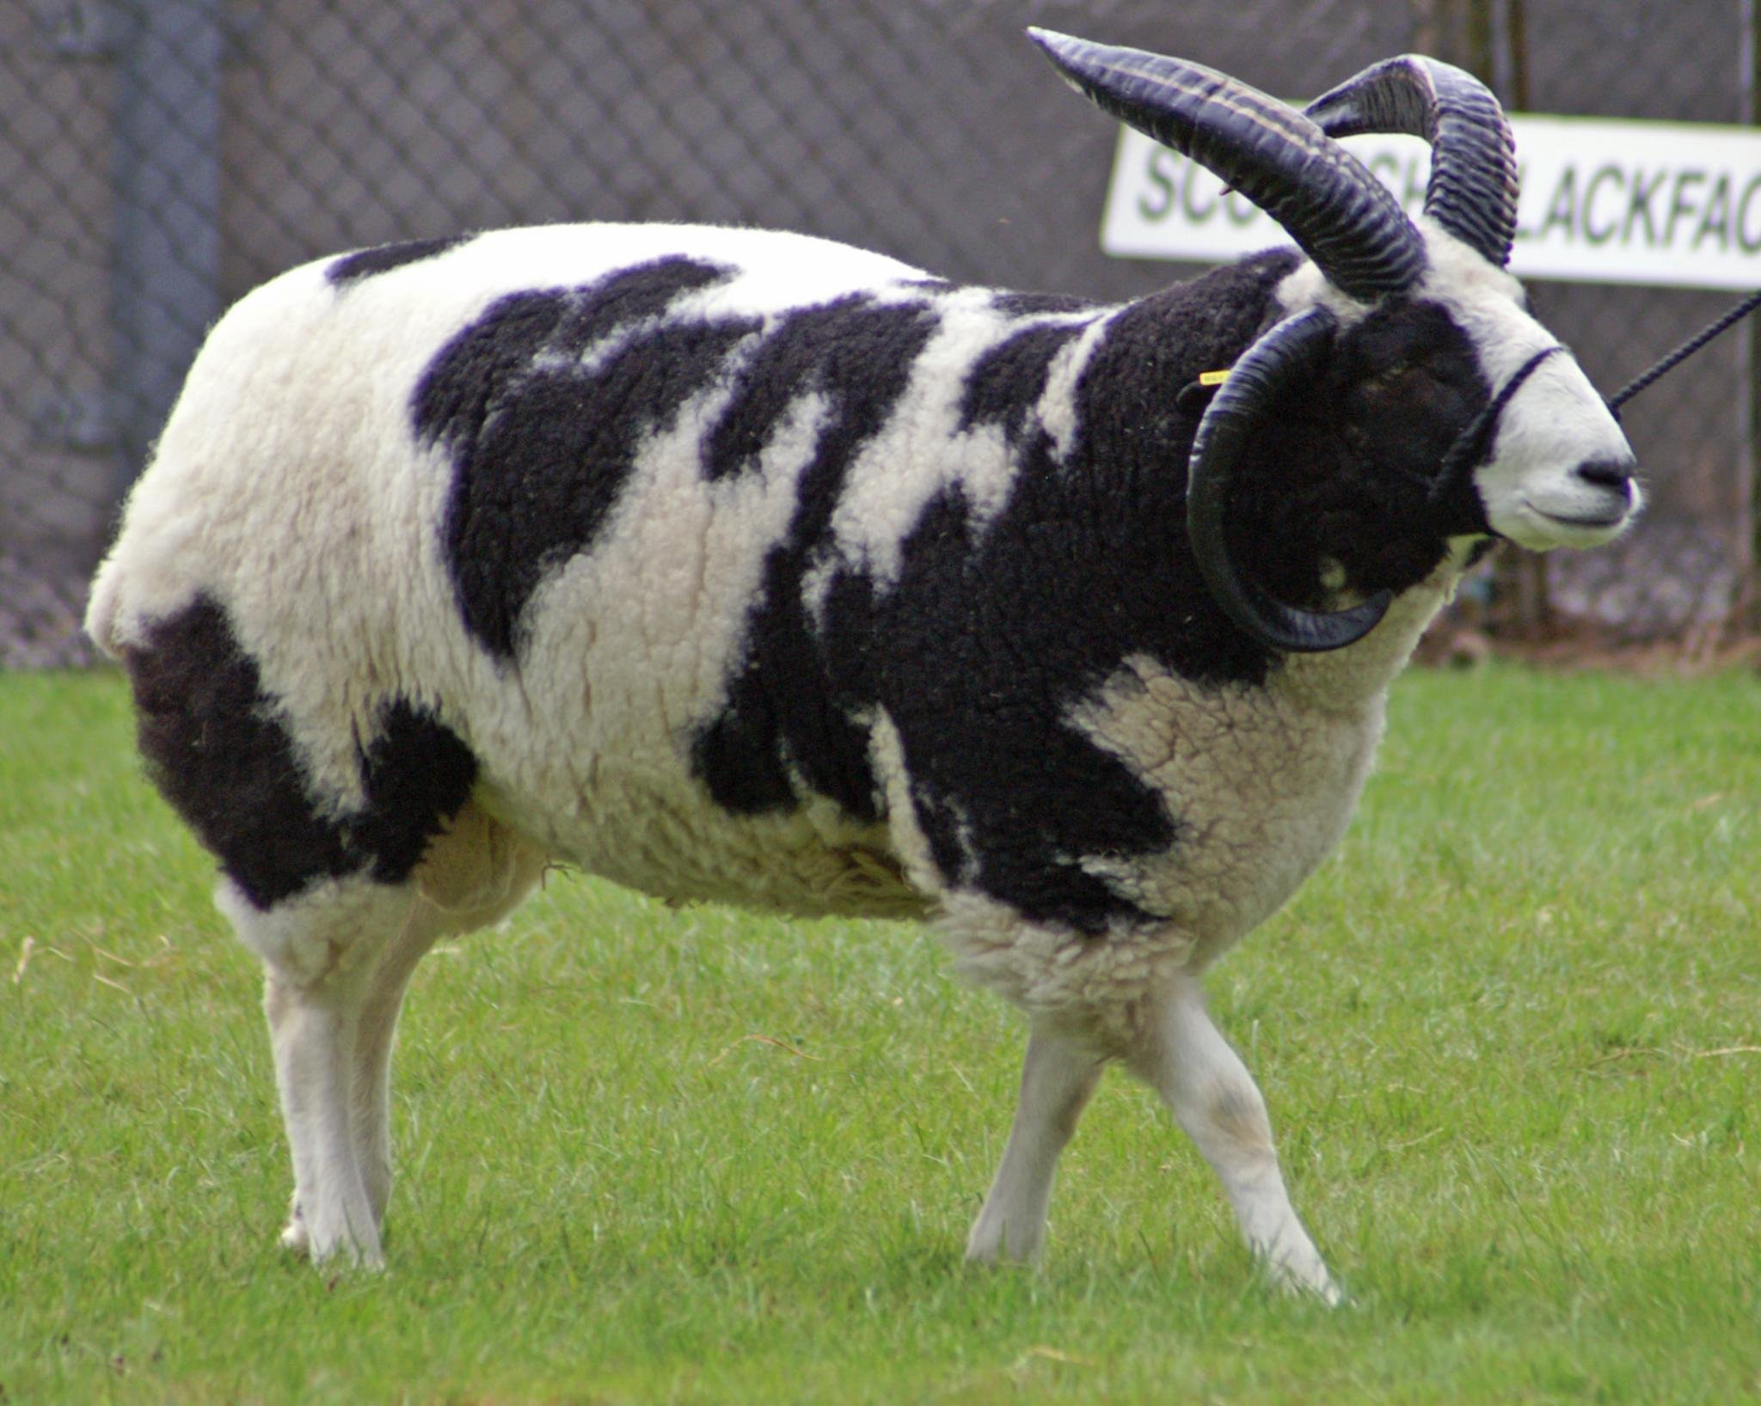
Poplar Genesis 30:37
The poplar is noted for its tall straight growth and ability to thrive in moist environments. This made it a symbol of fertility and life in biblical times, contributing to it’s use in rituals and symbolic acts, as well as being a source of shade and useful wood.
We are told that Jacob used poplar and hazel rods to encourage the flocks of the sheep, goats and cattle that he cared for to have offspring with dark markings, which he could keep for himself. Jacob’s Sheep is still a recognised breed today
A Jacobs Sheep
Back to grid

Slide 16
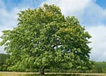
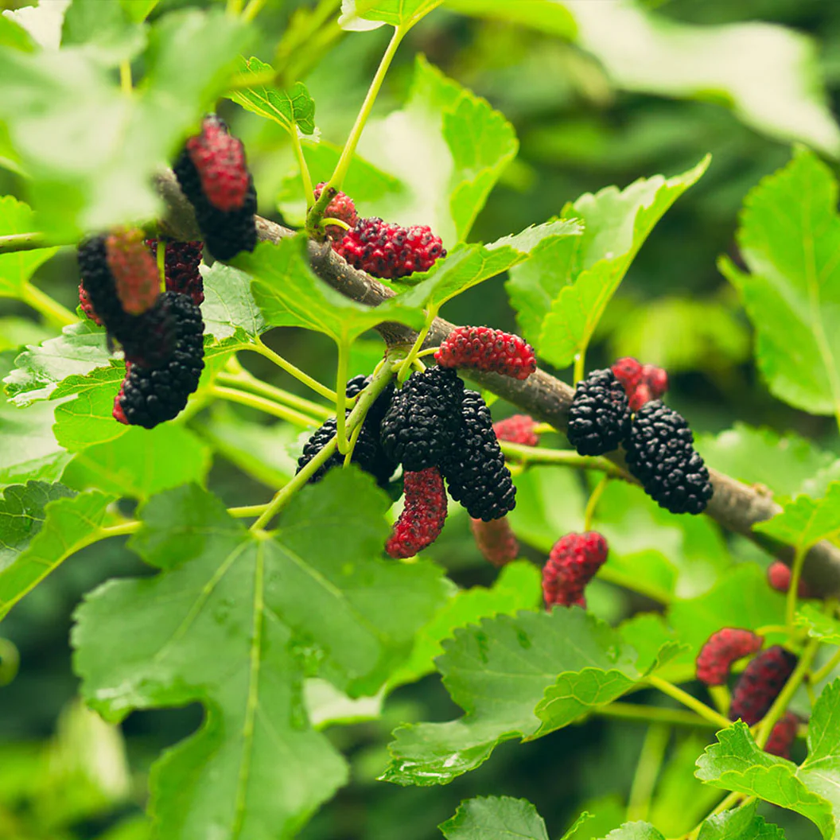
Sycamore or Mulberry
Luke 17:6
Another tree where translations differ. The Authorised Version makes Jesus refer to a sycamore tree while the Revised Standard Version makes Him refer to a Mulberry tree. It would appear to depend on how you read the original Greek text. In the context that Jesus is quoted it doesn’t make much difference, since He is using it as an illustration of what faith can enable you to do.
We know the 5-pointed leaf and ‘helicopter’ winged seeds of the sycamore tree. The mulberry tree is not so common. It has heart-shaped leaves and fruit similar to blackberries
A sycamore tree
Back to grid
Mulberry leaves & fruit

Slide 17
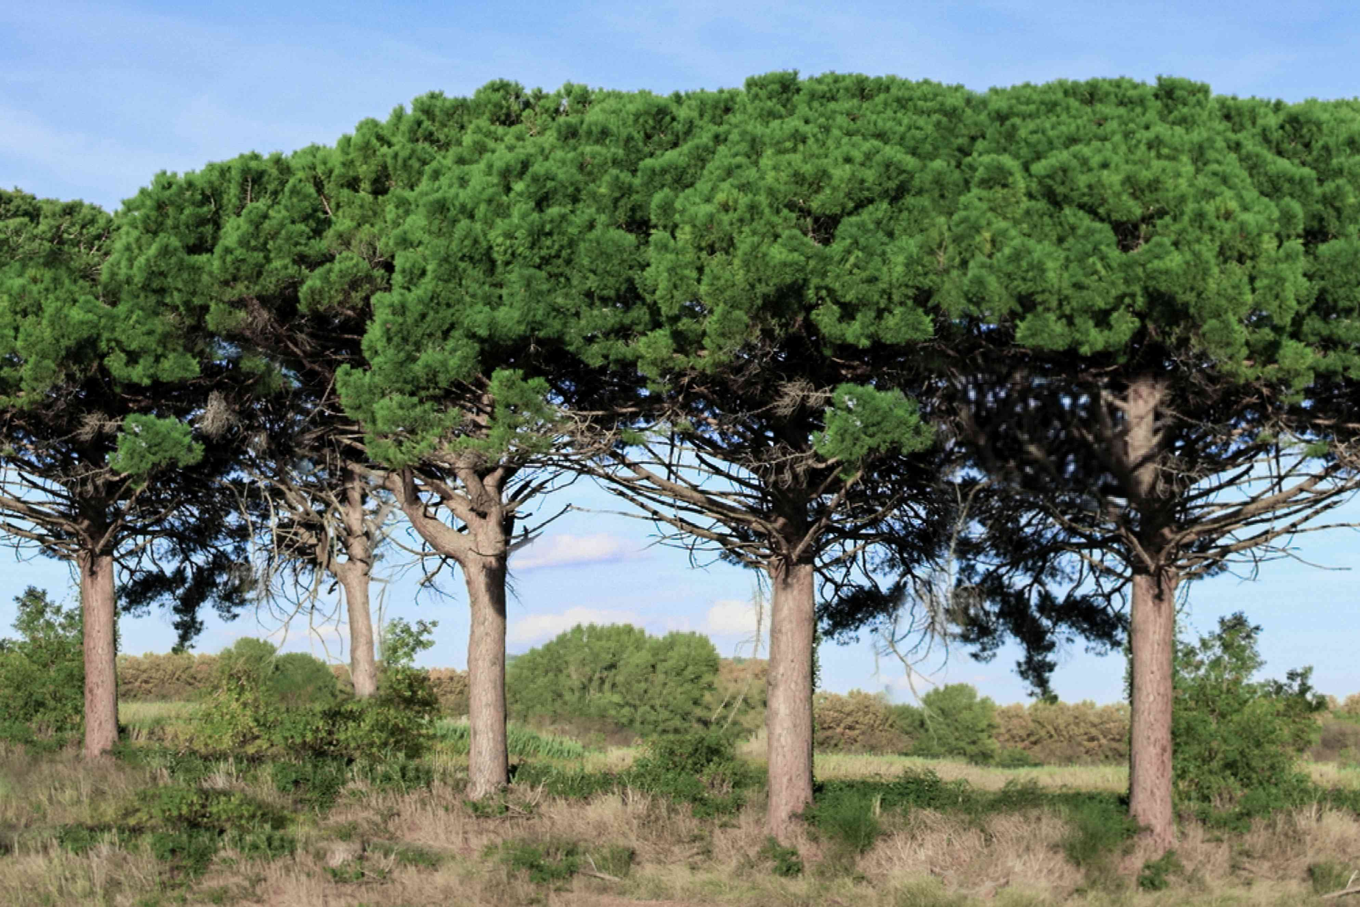
Fir or Pine
Isaiah 41:19; 60:13 and others
While all pine trees are types of fir, not all fir trees are pine trees. Some translations of the bible make reference to both. Being used to a warmer, drier climate the Mediterranean Pine is different to the Scots Pine and Douglas Fir that we know in the UK,. However, all pines and other fir trees can look similar when young (think of the similarity of different types of Christmas tree). Their beauty, strength and prosperity due to their deep tap root and spreading surface roots, and their great height are used to represent the beauty, strength and vastness of God’s Creation.
Back to grid

Slide 18
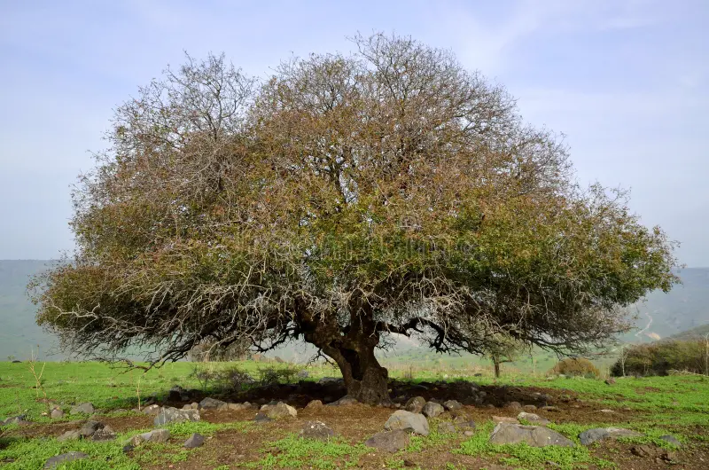
Oak Joshua 24:26; Isaiah 44:14; 61:3; Zechariah 11:2
Another symbol of strength, endurance and divine presence, serving as a sacred space for divine encounters and covenants. Its deep roots and robust structure mirrored steadfast faith, while its ability to withstand harsh conditions represented the resilience of believers.
Today there are 3 main species of oak to be found in the Holy Land, all playing a vital part in the ecosystem of the area, providing both habitat and food for various wild species
Back to grid

Slide 19
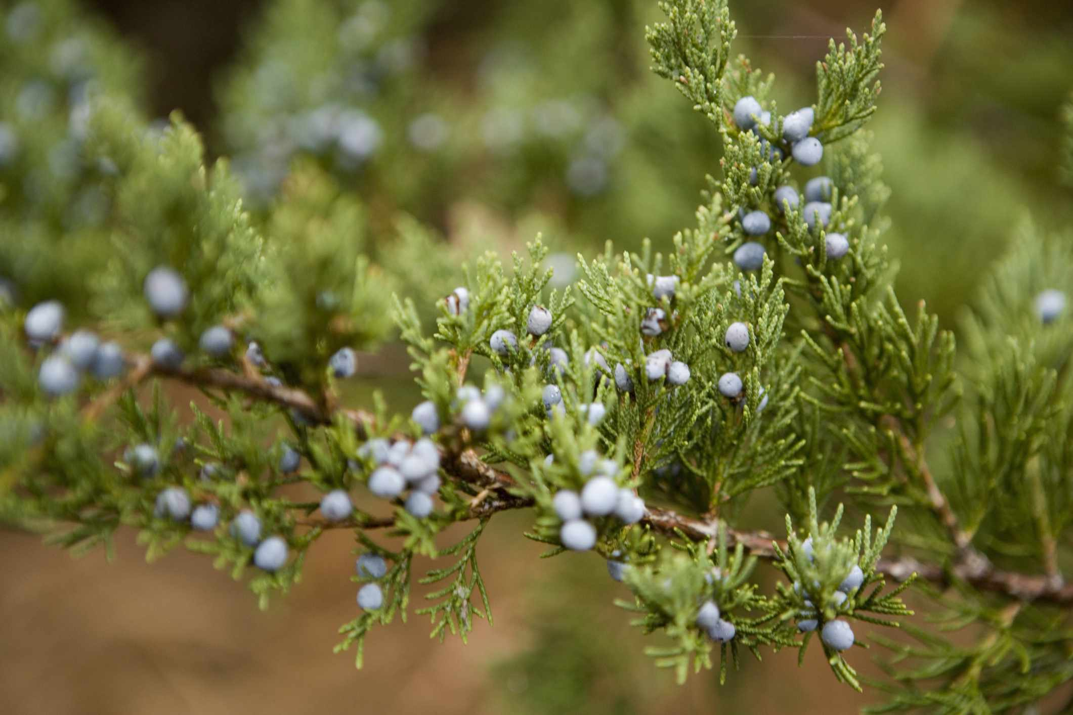
Juniper 1 Kings 19:4-5; Job 30:4; Psalm 120:4
The Juniper tree in the bible symbolises protection, resilience and divine provision. 1 Kings 19 recounts the story of Elijah fleeing from Queen Jezebel. In despair he sat down under a juniper wishing to die, but God sent an angel with comfort and sustenance – He still had a use for Elijah.
Today juniper berries are known as a flavouring for foodstuff. They also have medicinal and health benefits, and juniper oil, distilled from the berries, is used in cosmetics
Back to grid

Slide 20
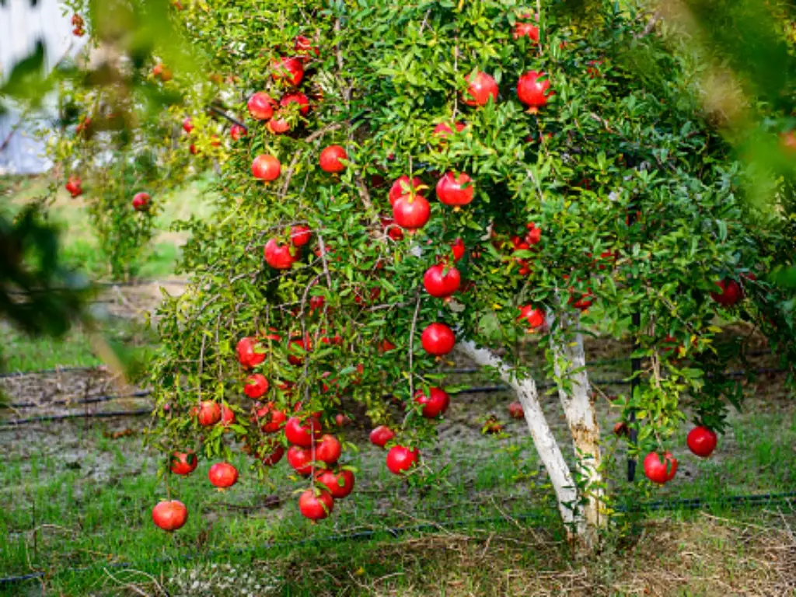
Pomegranate Exodus 28:33-34; 39:24; Numbers 13:23; 1 Samuel 14:2; 1 Kings 7:18-20; and others
Pomegranates are mentioned throughout the bible. Not only were they eaten, their image was used for decoration of both the High Priest’s robe (see Exodus) and 1 Kings tells of great rows of them being carved on the wood of Solomon’s temple. The fruit represents fruitfulness, knowledge, learning and wisdom. The Jewish tradition is that it is a symbol of righteousness because it is said to have 613 seeds, the same number as the commandments of the Torah.
Back to grid

Slide 21
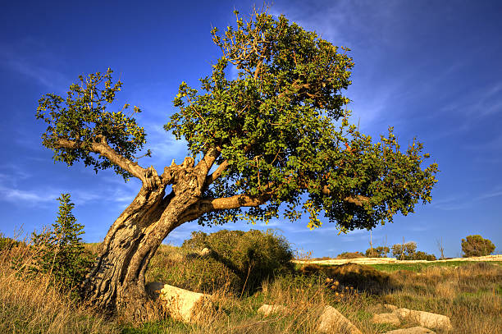
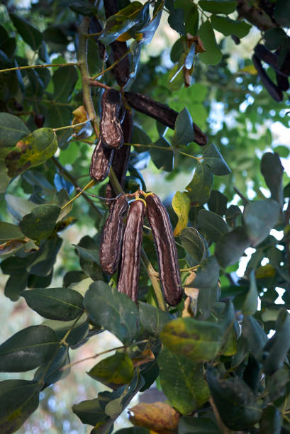
Carob or Locust Matthew3:4; Mark 1:6
Both Matthew and Mark describe John the Baptist as eating “locusts and wild honey”. It is possible that he ate the swarming insects that can plague the Holy Land and much of Africa, since some types of locusts are considered kosher under the Mosaic law (and are still eaten in parts of Africa). But they only appear at certain seasons. It is more likely that he ate locust beans or carobs. The carob fruit is a bean pod with up to 15 seeds and taking 11 months to ripen. It has a unique flavour. Powdered, it tastes like chocolate, and Jews use it as a dairy substitute in foods eaten with meats. Fresh pods taste like a date. Green young pods can be cooked and eaten as a vegetable, smashed seeds of the dried pods can be cooked as porridge. The pod is rich in magnesium, calcium, phosphorus and copper, as well as a range of other essential vitamins.
The tree grows up to 17m tall and has a broad green crown.
Back to grid

Slide 22
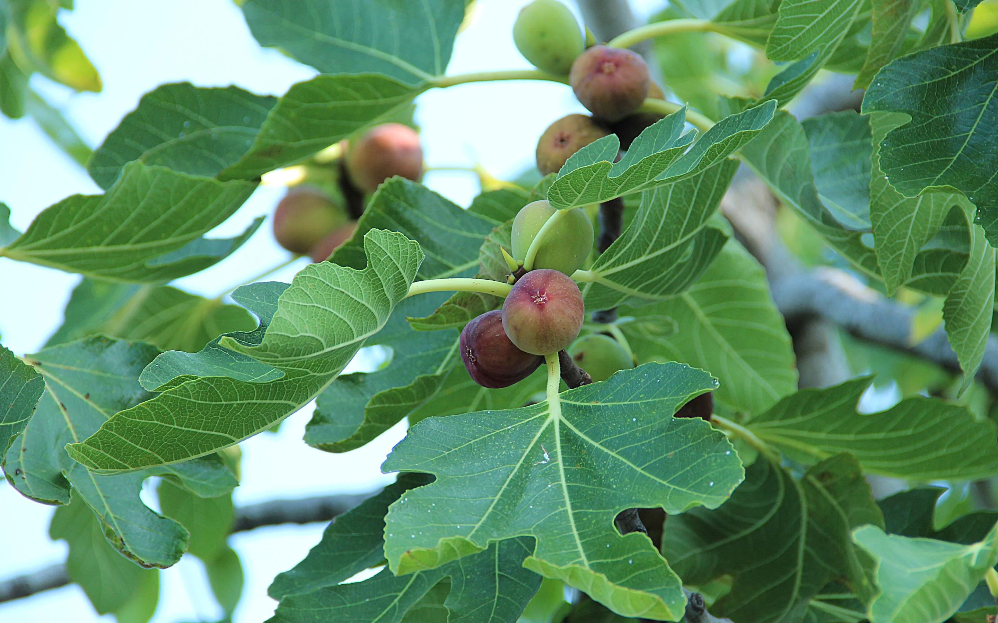
Back to grid
Fig
Joel 1:7; Micah 4:4; Matthew 21:18-22; Mark 11:12-25
The fig tree is native to the Mediterranean and western and southern Asia. It has been cultivated since ancient times and is now widely grown throughout the world. In the bible it is often used to symbolise the nation of Israel and its spiritual condition.
In 2018 the world production of raw figs was 1.14million tonnes, with 64% of that produced by Turkey, Egypt, Morrocco and Algeria

Slide 23
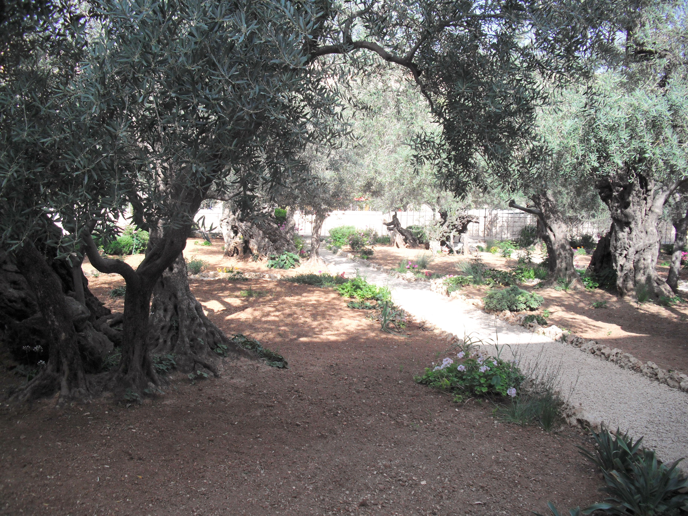
Back to grid
Olive
Genesis 8:11; Judges 9:9; Psalm 128:3 & others
We all know olives and olive oil but may not be so familiar with the tree that produces them and has been known for millennia. In ancient times, before money was invented, olive oil was used as a system of currency throughout the Mediterranean area.
This picture shows the Garden of Gethsemene, where Jesus and His disciples went after The Last Supper. The olive tree on the right is estimated to be over 2000 years old, and it is believed that, as a very young sapling, it would have seen Jesus there.

Slide 24
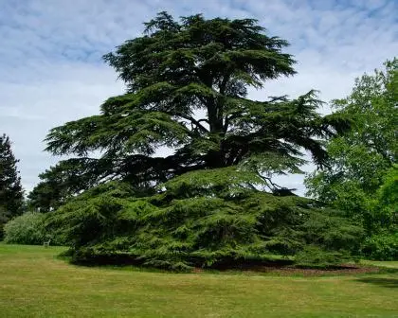
Cedar of Lebanon 1 Kings 4:33; 5:6–10; 2 Kings 19:23; Isaiah 41:19
The Cedar Trees of Lebanon have long been well known. One appears on the national flag. Because of its height and durability the tree is often seen as a symbol of strength, wisdom and spiritual growth. It’s considered sacred in various cultures and religions, a link between heaven and earth and indicative of divine presence. King Solomon bought cedar wood to build the first temple in Jerusalem.
Back to grid

Slide 25
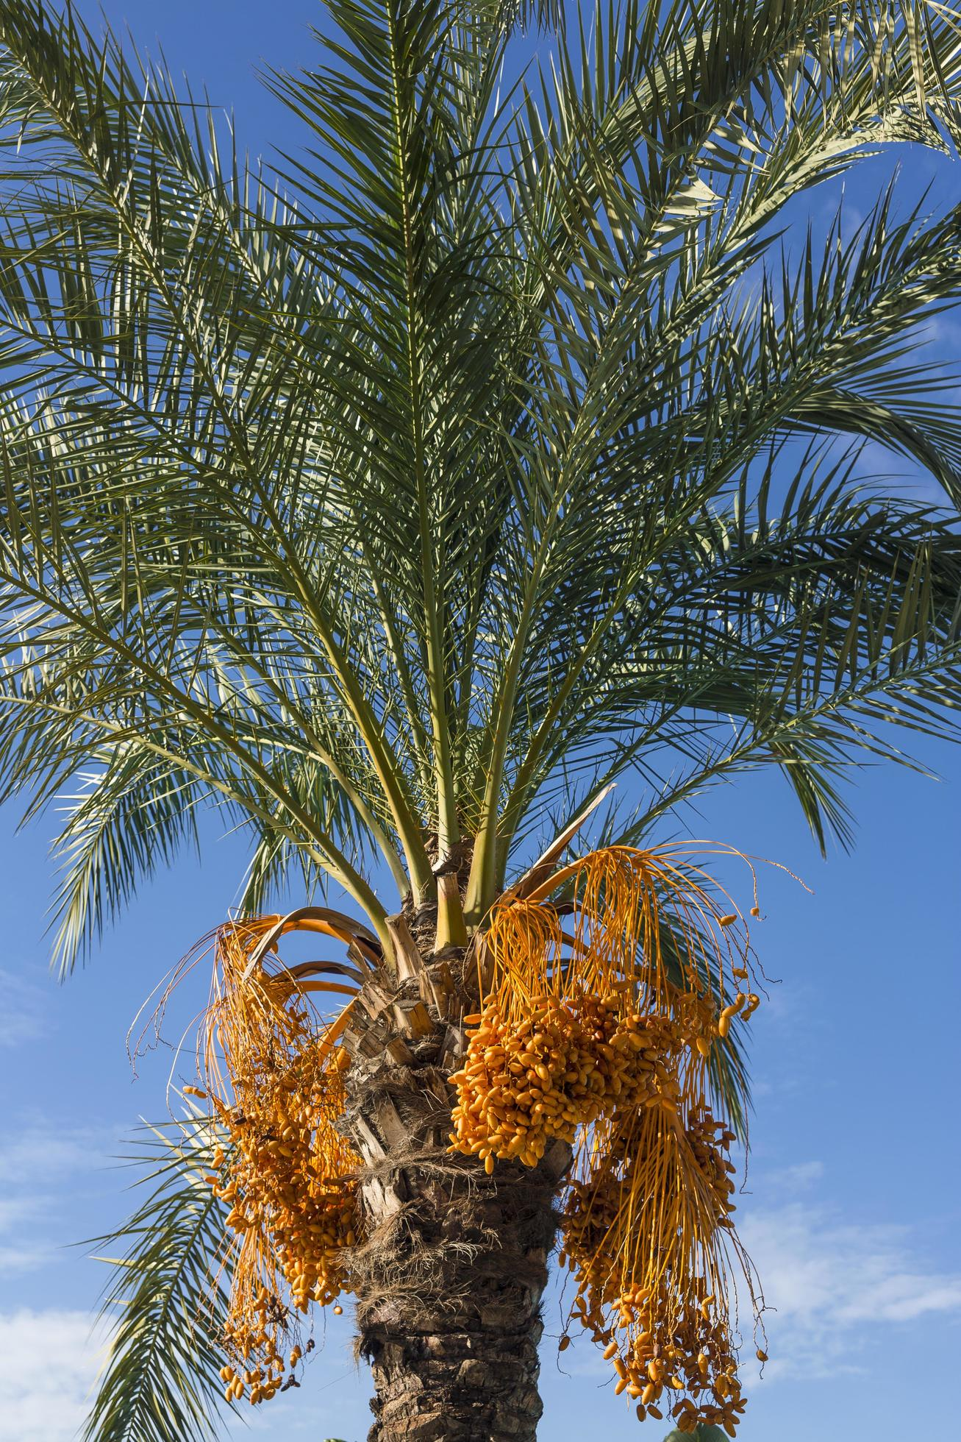
Date Palm Song of Solomon 5:11, 7:7—8; John 12:13
A date palm can grow as high as 75 feet, and they have been prized as a commodity throughout history. They are among the oldest cultivated trees in the world. They are believed to have been cultivated in Mesopotamia as early as 4000 BC, where they were considered a symbol of fertility and prosperity. Ancient Egyptians used them not just for their nutritious fruit but also to make wine and for building materials. They can live for over 100 years and some produce fruit for more than 60 years. They are a symbol of hospitality and generosity in many Arab countries
Back to grid

Slide 26
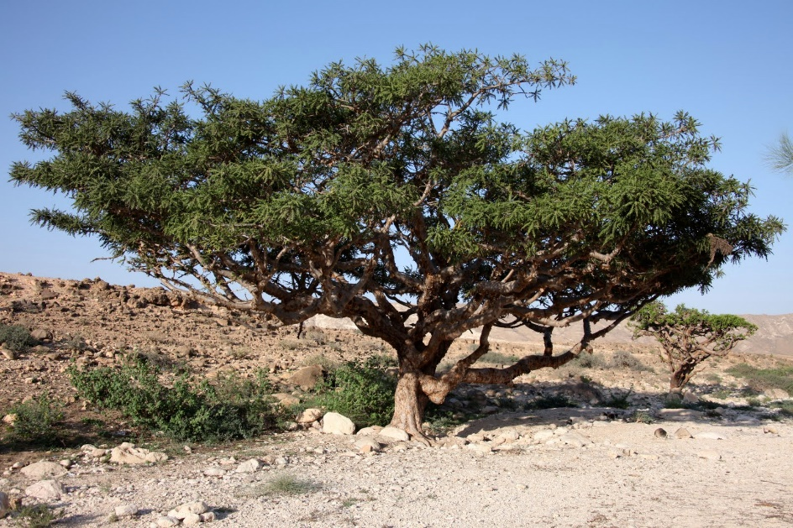
Fankincense & Incense Hosea 4:13; Matthew 2:10 - 11
One of the gifts presented to the infant Jesus by the 3 Wise Men. Frankincense is an aromatic resin used in incense and perfumes. It comes from trees of the genus Boswelia in the family Burseraciae. The word is from Old French, franc encens ('high-quality incense’). The trees start producing resin at about 8 to 10 years old, and tapping is done two to three times per year. Today 90% of the world's production comes from the Horn of Africa, predominantly from the border communities on the Somalia/Ethiopia border.
Back to grid

Slide 27
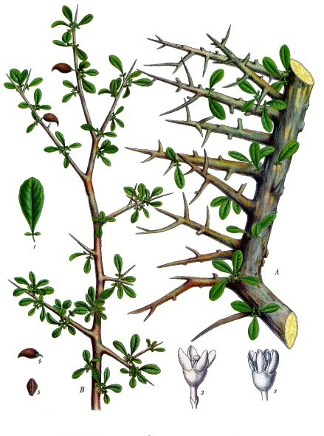
Myrrh Genesis 37:25, 43:11; Exodus 30:23-25; Matthew 2:11; Mark 15:23 & others
Another of the gifts presented to the infant Jesus by the 3 Wise Men. Myrrh gum is commonly harvested from trees of the genus Commiphora by making a deep cut through the bark into the sap wood, causing the bush or tree to ‘bleed’ resin which solidifies as a gum. Myrrh was known from Egyptian times as a perfume and to have medicinal attributes. It was used for embalming, and St Mark’s Gospel describes it as being in the drink Jesus was offered on the cross.

Slide 28
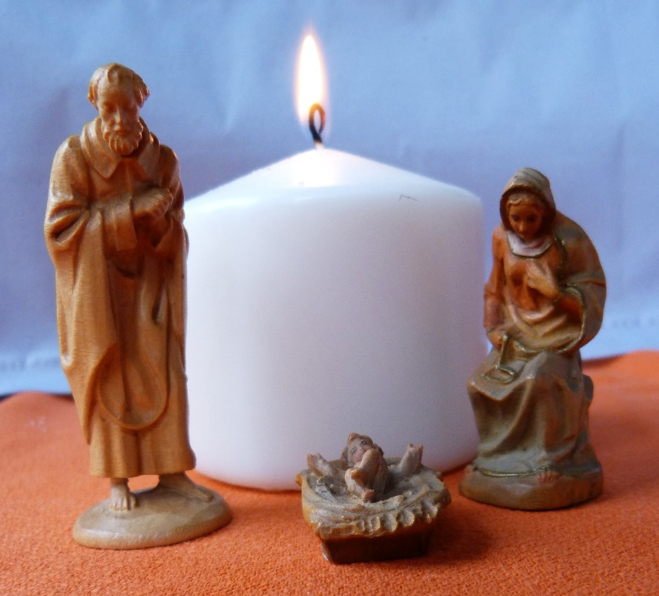
Have a very happy and peaceful Christmas
Back to grid

