Slide 1
Advent Calendar 2024
Plants of the Bible

Slide 2
The plants mentioned in the bible are not the only ones to be found in the Holy Land, and not all of those mentioned are included here. Many you will recognise. You will note that there are no trees or bushes. That is because they will have a calendar of their own another year.
Pick today’s date on the grid to see what today’s plant is.
When you have finished select ‘Back to Grid’ before you shut down, ready for tomorrow.

Slide 3
1
2
3
4
5
6
7
8
9
10
11
12
13
14
15
16
17
18
19
20
21
22
23
24

Slide 4
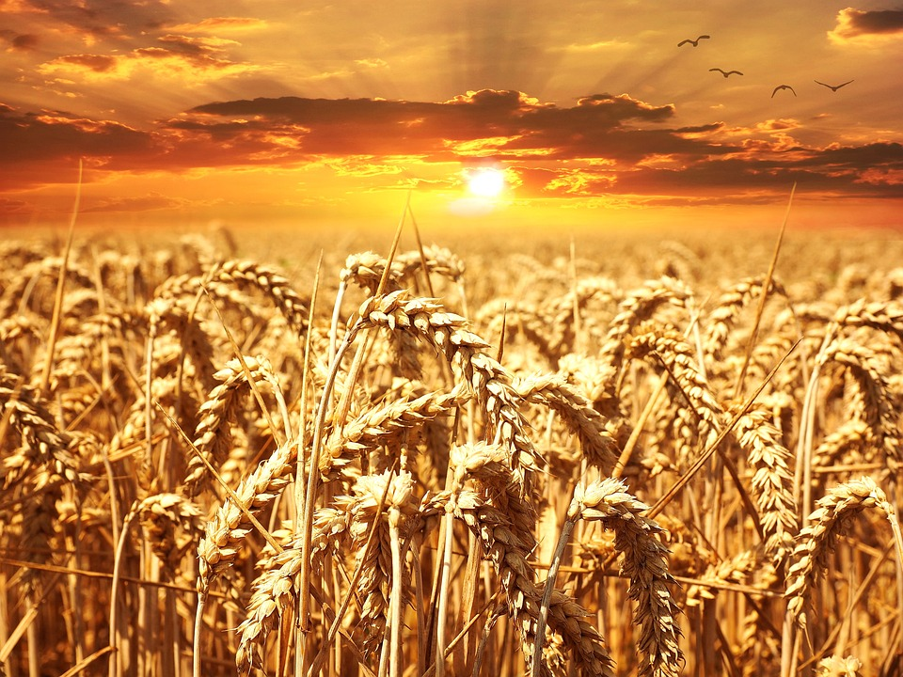
Wheat Genesis 30:14; Ezra 7:22; Ezekiel 4:9; 2 Samuel 17:28
There are 38 verses mentioning wheat in the bible. Depending on the context of the story, wheat can represent a symbol of God’s provision, harvest, and judgement.
In some parts of the world wheat grains are still trodden out of the ear by cattle or crushed out with a type of sledge or a big heavy wheel. It is then winnowed (separated from the chaff) by throwing up in t he air with a shovel or wide fork on a windy day, just as it was in Jesus’ time.
BACK TO GRID

Slide 5
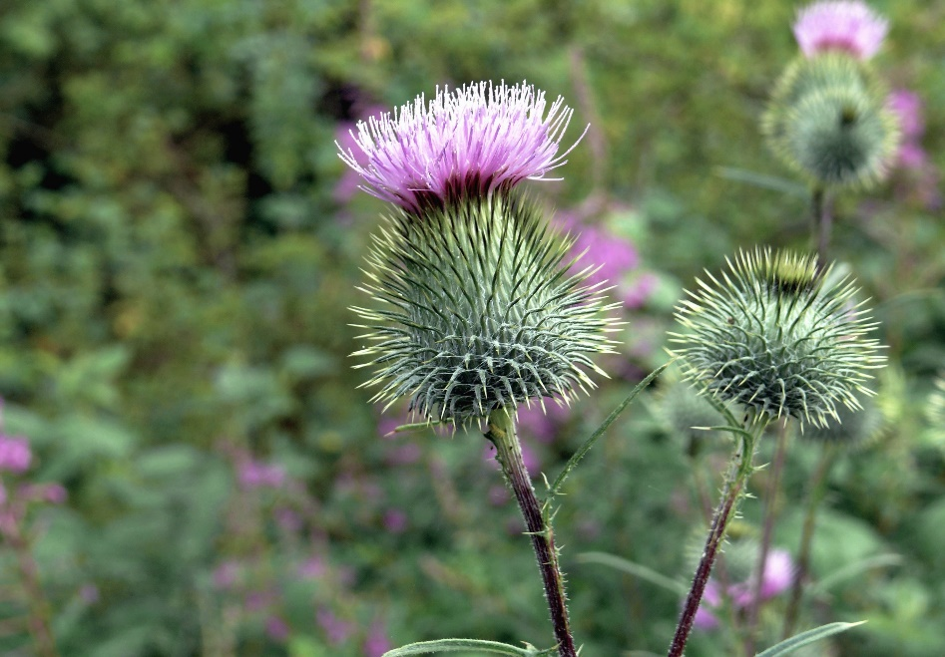
Back to grid
Thistle
Job 31:40; 2 Chronicles 25:18
Thistles appear in biblical stories as representative of difficulties or challenges – anyone who has ever tried to extract one from their garden will understand why. It is also associated with the consequences of disobedience or sin.
They may be annoying and spiky, but are actually a group of flowering plants with diverse shapes and colours that provide food and shelter to a number of insects, including bees and butterflies, so they are not so bad after all. And remember, God made them too!

Slide 6
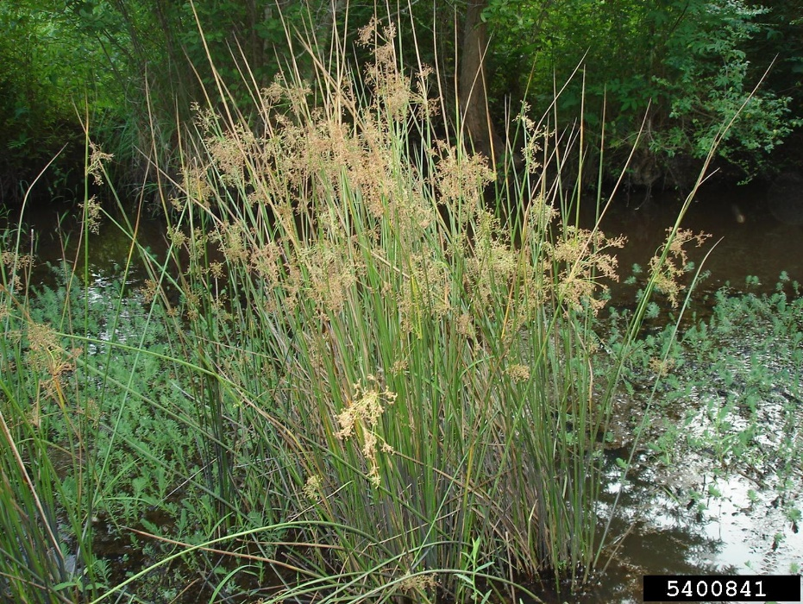
Bulrush or Papyrus
Exodus 2:3; Job 40:21
The only reference to the bulrush is in the story of the infant Moses being hidden in his basket in the rushes by the River Nile. It is not the type of rush or reed portrayed in some paintings – that is the reed mace with its big brown seed head, often seen in the UK. It is generally agreed that the biblical reference is to the papyrus plant which grew abundantly in the Lower Nile in antiquity, although it is no longer found there. The bulrush grows to some 12 – 15 feet (about 3.7 – 4.5m) tall and was sometimes plaited into ropes.
Back to grid
This Photo by Unknown Author is licensed under CC BY-NC

Slide 7
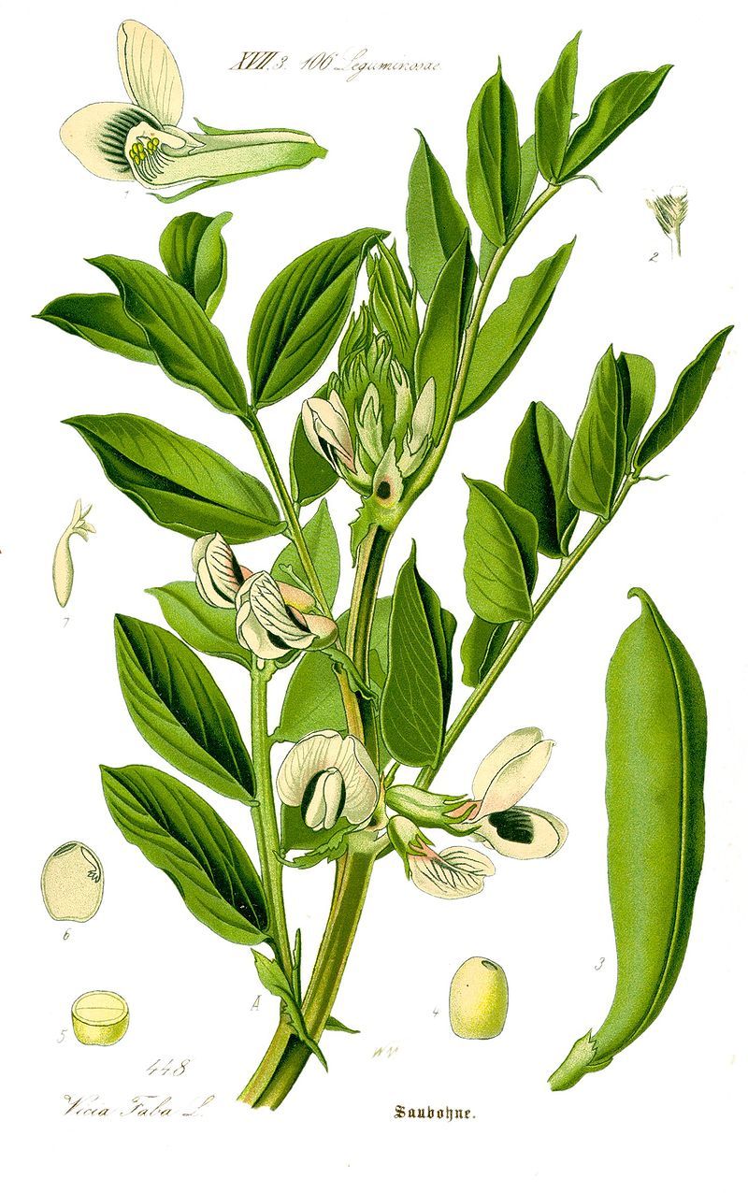
Back to grid
Bean
Ezekiel 4:9; 2 Samuel 17:28
This is believed to be the common bean, Latin name vicia faba, that we know as the broad bean. Wikepedia tells us that this bean has a long tradition of cultivation in the Old World. It is one of the oldest plants in cultivation, and one of the easiest to grow. Its wild ancestor has not been identified but domestication of the crop is now thought to have begun as early as 8250 BCE

Slide 8
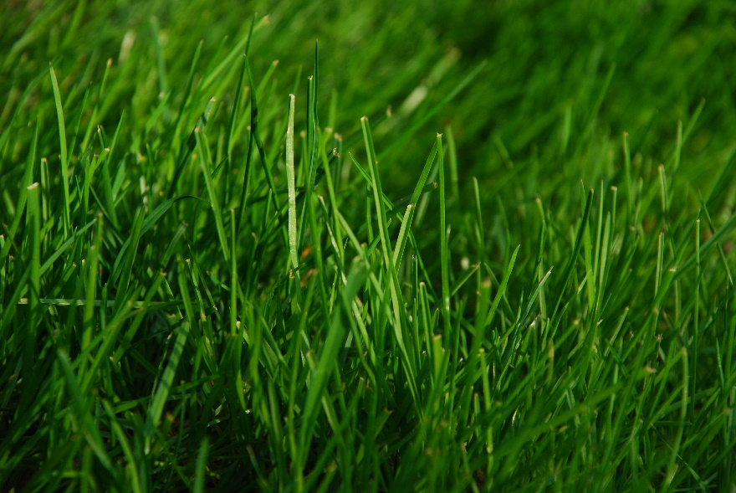
Back to grid
Grass
Matthew 14:19; Mark 6:39; John 6:10 and others
We all know what grass looks like, whether it is on a mountainside, or a garden lawn, a village green or a sports pitch, or simply growing beside the road or path. It would be surprising if such a common plant did not get a mention in the bible, and it does – 58 times. It can be somewhere to sit, something with which to compare human life and as a symbol for fragility

Slide 9
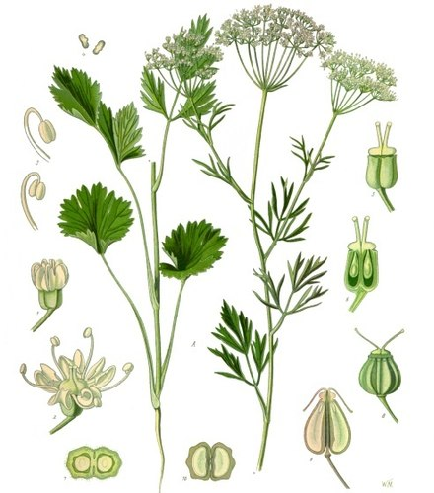
Back to grid
Anise
Matthew 23:23
Anise grows naturally in the wild in Mediterranean countries, including Egypt, and is also cultivated now. It has been used for thousands of years and is still used for cooking (think of star anise, the seed head), as well as in drinks and sweets. It has medicinal properties, containing high amounts of manganese. It is also believed to deter lice and biting, itch-inducing insects.
It is thought possible that some references in the bible have become confused in translations down the centuries, and what the original Greek referred to was sometimes dill. To the non-expert eye the plants look similar, except for dill the flowers are yellow, not white.

Slide 10
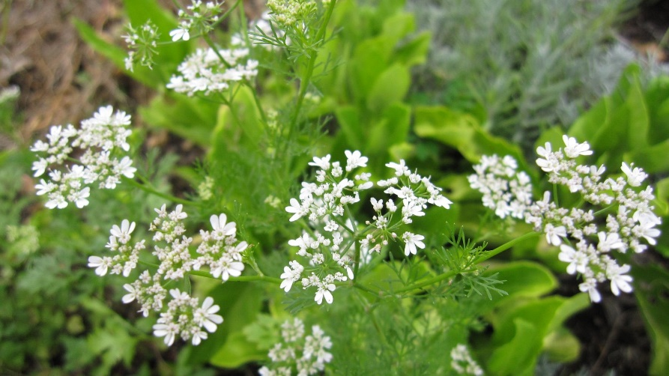
Back to grid
Coriander
Exodus 16:31
A native of southern Europe ad western Asia, and related to anise and caraway, it was used in Egypt to spice bread, and so was well known to the Israelites. They used it as a visual comparison when describing to others what the manna looked like when it fell from heaven to provide them with food in the Sinai Desert.

Slide 11
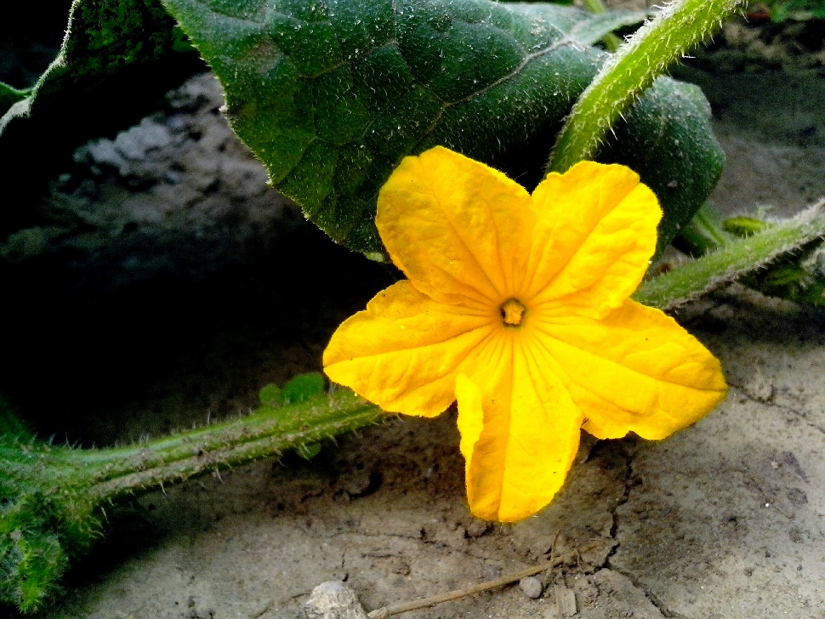
Back to grid
Cucumber
Numbers 11:5
The cucumber is still commonly grown in Egypt and Palestine, although careful breeding over the centuries has probably produced the plant and fruit that we know today. Perhaps in ancient times it was more like the ridge cucumber that today is used for pickling.

Slide 12
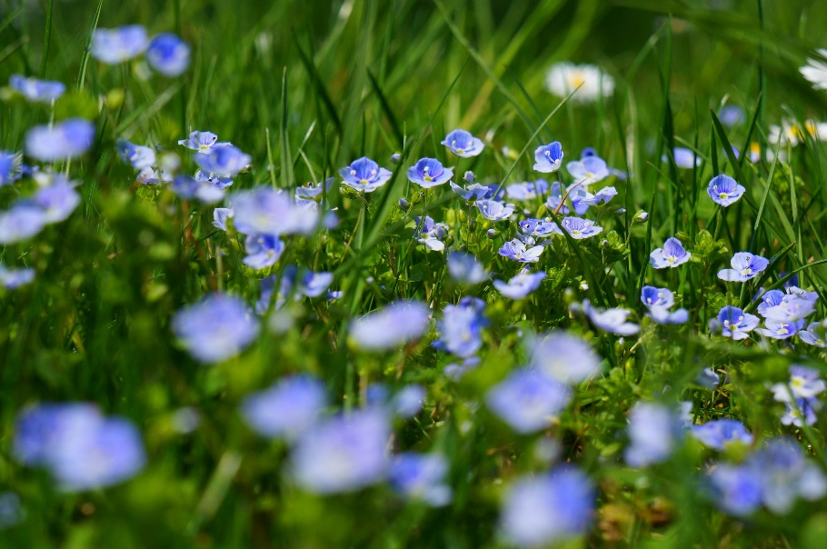
Flax
Proverbs 31:13
Flax is the earliest known fibre plant and was cultivated to make linen. It is still used for this today, as well as for harvesting the seeds, which have long been known to be beneficial to the diet. Fields of blue flax flowers can beseen in the UK at the right time of year.
The ancient Egyptians, and especially the pharaohs and high-ranking officers, wore linen. In later times the High Priest wore an ephod (a type of apron) made of linen when ministering before the Lord’s altar.
Back to grid

Slide 13
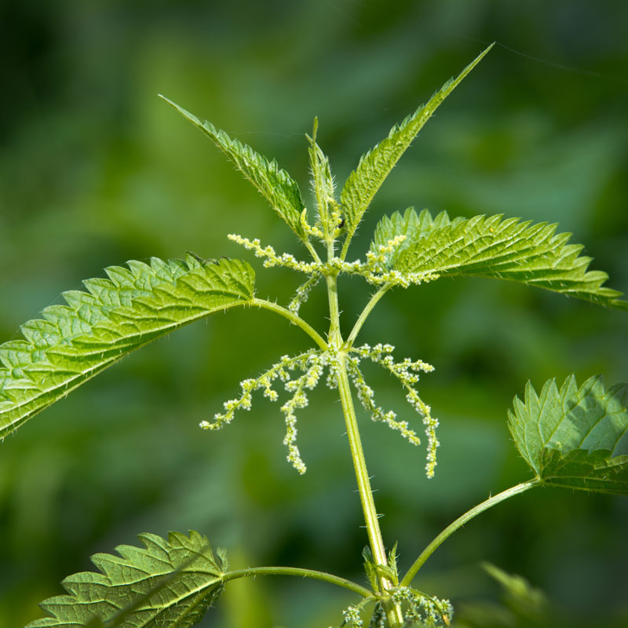
Nettle Isaiah 55:13 and others
Is there anyone who has not come into contact with a stinging nettle?
The largest stinging nettles have been common in the ruins and other similar places in the Holy Land for centuries. Jesus and his disciples would have known it – and doubtless tried to avoid it.
Back to grid

Slide 14
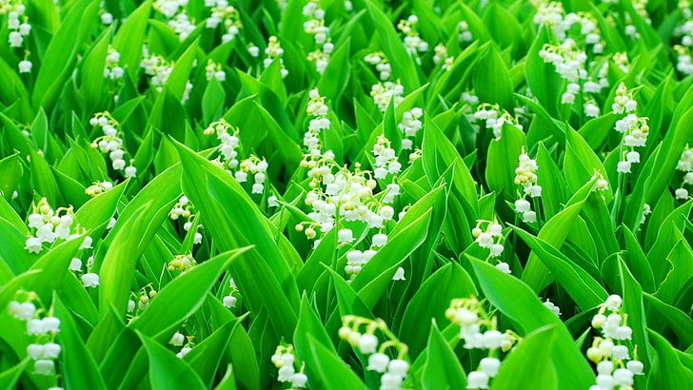
Lily of the Valley
Song of Solomon 2:1
In the bible this plant symbolises purity, humility and the Love of God. In the Song of Solomon it is portrayed as a beautiful and much cherished flower, a symbol of growth and hope.
Some think this was also the “Lilies of the Field” that Jesus compared with Solomon “in all his glory”, who couldn’t match them for loveliness because God provided their ‘clothing’.
Back to grid

Slide 15
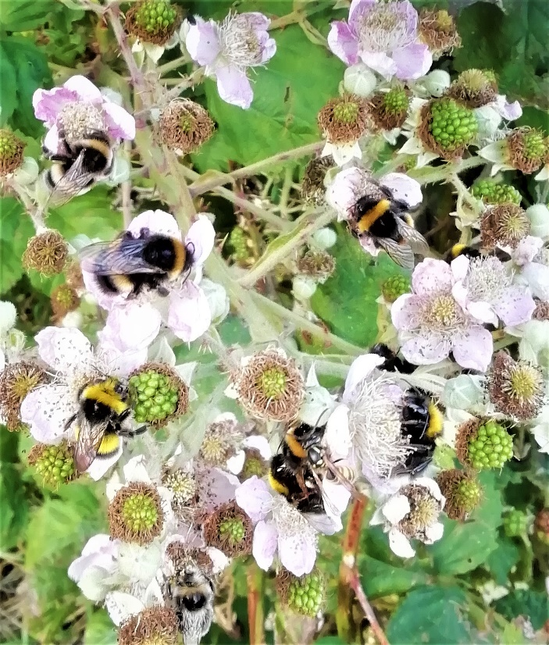
Bramble Judges 9:15
Brambles, as anyone who has worked in the St Francis church garden will tell you, grow anywhere and everywhere, and are very difficult to remove. Their advantage, though, is the attractive flower heads and the blackberries that are produced at the end of summer, thanks to their attraction for bees, as shown here. Were the brambles of the bible were different – we will never know.
Back to grid

Slide 16
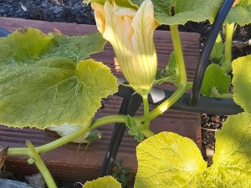
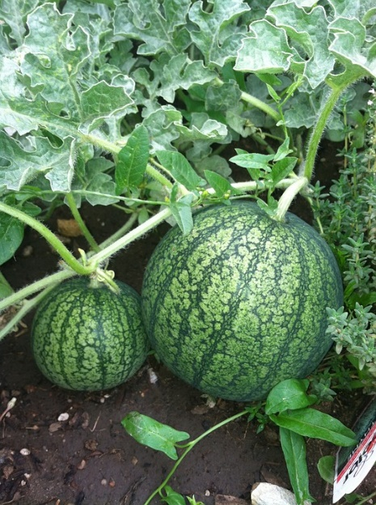
Melons (or possibly Watermelons)
Numbers 11:5
This is the only place where melons are mentioned in the bible, and the same word is thought to refer to both melon and watermelon. The two plants look very similar, and both are common in the eastern Mediterranean countries and Egypt. It is thought that the reference to these and other fruit here shows how much the Israelites were missing all the good things that they had while enslaved in Egypt, and that they had forgotten how hard life had been.
Back to grid

Slide 17
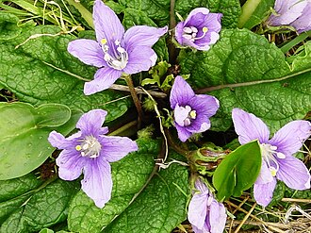
Mandrake
Genesis 30:14-16
The Hebrew word for the mandrake means ‘love plant’. The modern plant is a strange-looking member of the potato family with a root that is supposed to look similar to the shape of the human figure. It grows wild throughout the Eastern Mediterranean region. Its smell is said to be sickly but not unpleasant; its taste sweetish. There are other species, such as the English Mandrake and the American Mandrake
Back to grid

Slide 18
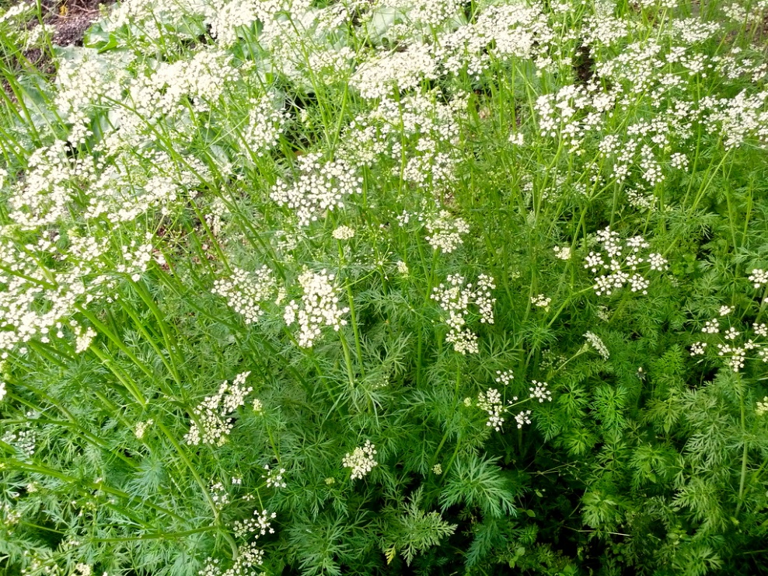
Cumin Isaiah 28:27; Matthew 23:23
Isaiah describes how both Cumin and Black Cumin seeds were beaten out with a rod or a stick respectively. It was important to do it the right way. The seeds were used to flavour bread and stews, and still are by chefs today.
Back to grid

Slide 19
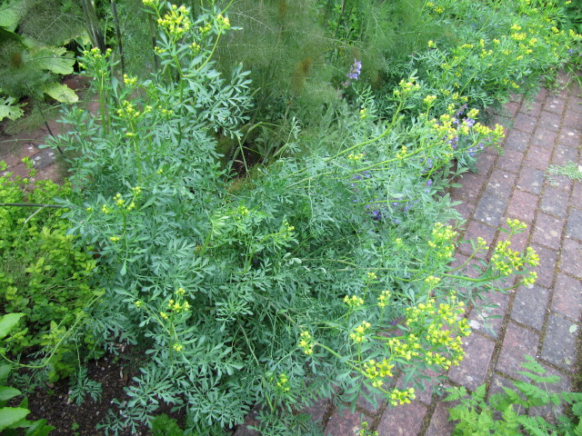
Rue Luke 11:42
Rue was commonly grown in biblical times and the practice has continued in the cottage gardens of Europe and the UK for centuries. It has a strong odour and bitter taste and is associated with regret or sorrow.
Jesus criticised the pharisees for giving a tithe (one tenth) of rue even though it was not required by the Mosaic Law, and neglecting justice and the love of God
Back to grid
This Photo by Unknown Author is licensed under CC BY-SA

Slide 20
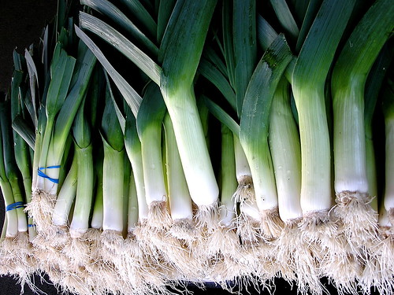
Leeks Numbers 11:5
In the wilderness of the Sinai Desert the Israelites longed for what they remembered as the good things of their slavery in Egypt. The leek was one such food item.
Leeks were highly valued in Ancient Egypt for their nutritional value.
Back to grid

Slide 21
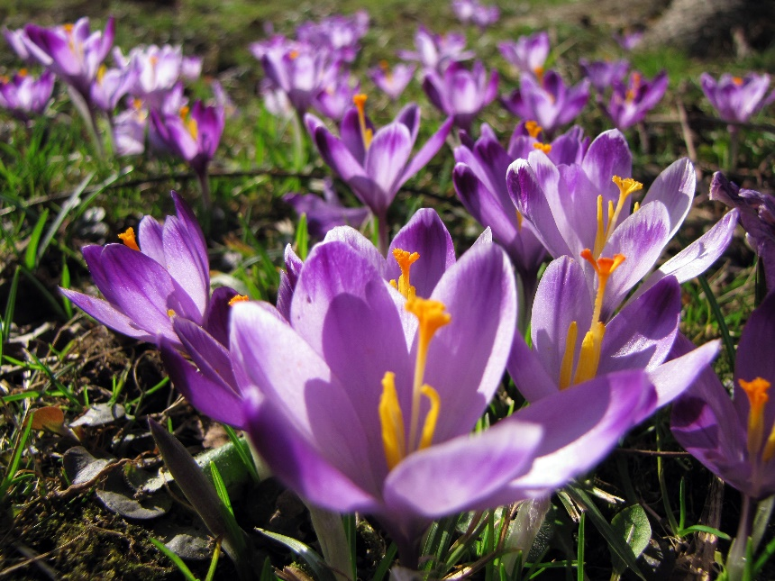
Saffron Crocus Song of Solomon 4:14
Saffron is the dried stigma and styles of the saffron crocus, and is the world’s most expensive spice because it is so delicate and picking it is very labour intensive. It is used to impart both flavour and a yellow colour to food and has also been used as a dye for textiles. Propagated in Eurasia originally, it has been traded and used for thousands of years, and documented evidence has been found in an Assyrian document dating to the 7th century BCE
Back to grid

Slide 22
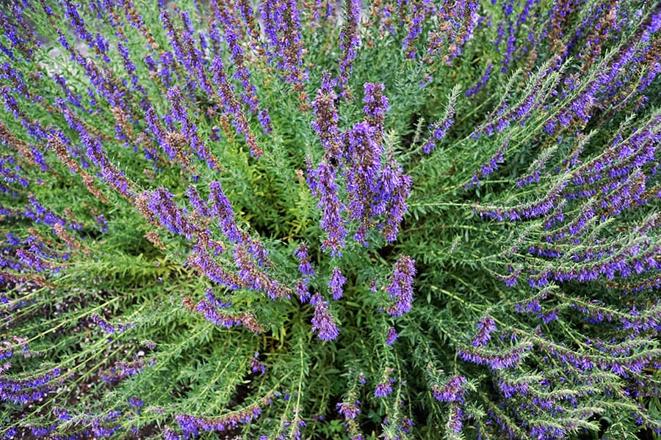
Back to grid
Hyssop
Leviticus 14:52 and others
Hyssop is an evergreen perennial plant that originally grew in Southern Europe, the Middle East and Asia to a height of about 30 cm.
The bible uses hyssop both as a plant for purification and for applying substances, rather like we would use a brush. It has symbolic meanings of cleaning, protection and spiritual renewal, reminding us of
God’s Love for us, the consequences of our actions and His willingness to forgive and heal us.
The biblical hyssop may not be the plant we know by that name, but a bunch of similar herbs, or the similar Syrian Oregano.

Slide 23
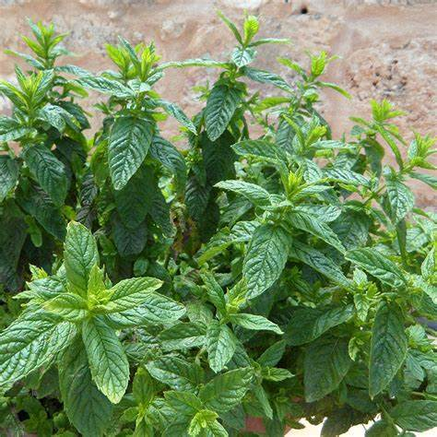
Back to grid
Mint
Matthew 23:23; Luke 11:42
The mint referred to in the bible is thought to be Horse Mint, which grows wild to about 3 feet (90 cm) tall. A tithe (tenth) of the dried, powdered mint leaves were carefully given by the pharisees. In Jesus’ day sprigs of mint were scattered on the floor of synagogues so that they gave off a pleasant aroma when walked on. They formed part of the “bitter herbs” eaten at Passover, and still do today.

Slide 24
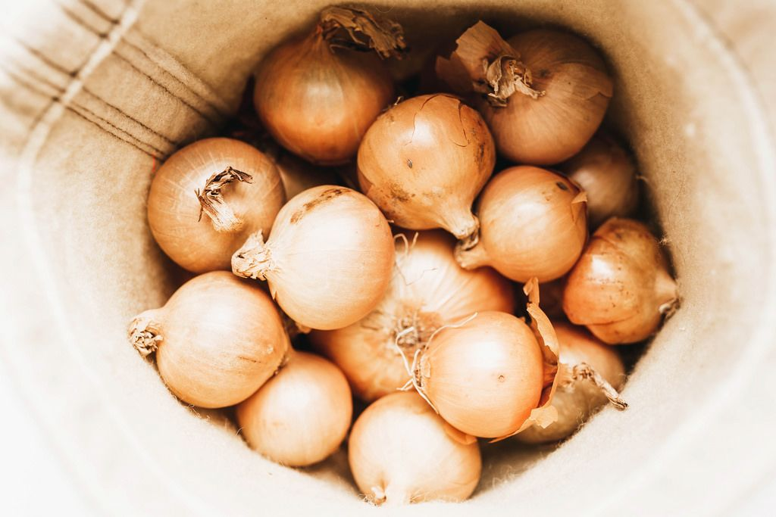
Onions Numbers 11:5
Probably smaller than the Egyptian onions of today, those that the Israelites remembered when in the Sinai Desert would have been of the same type, strongly flavoured and sweet. And, of course, they would have been remembered as being much nicer than they probably were. They are still grown on the banks of the Nile.
Back to grid

Slide 25
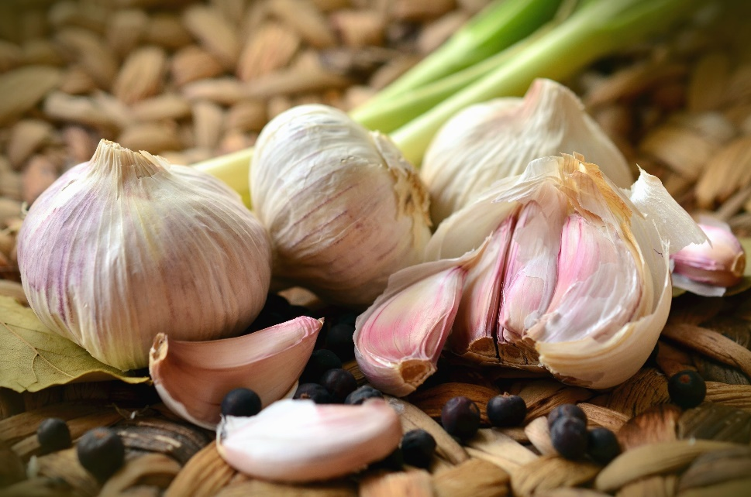
Garlic numbers 11:5
Originally a product of Central Asia, garlic was known to the ancient Egyptians and grown there. Undoubtedly it became grown and used in cooking in the Holy Land. Could some have been taken by the Israelites when they escaped from Egypt?
Back to grid

Slide 26
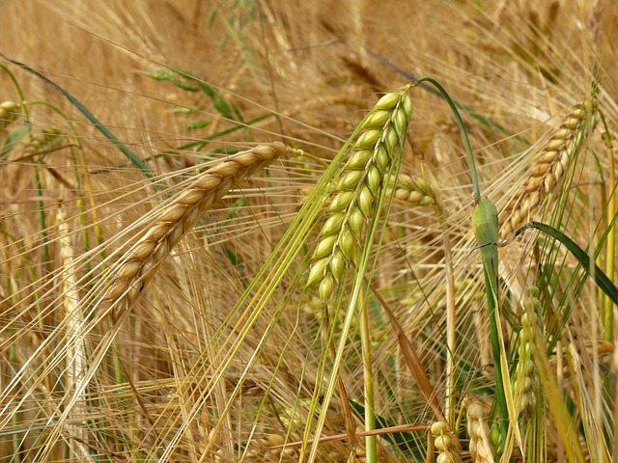
Barley Numbers 5:15; Ezekiel 4:9 2 Samuel 17:28
There are two Eastern Species: the two rowed and the six rowed. Both were harvested about 3-4 weeks before the wheat harvest. The barley was harvested about Passover time, so the plagues that hit Egypt ruined the barley harvest, while the later wheat harvest escaped.
In Israel barley was despised as the commonest and most easily grown grain crop, that was used by the poorest as well as for animal feed.
Back to grid

Slide 27
Grape Vine Genesis 40:9-10; John 15:1-7 and others
One of the seven species of plant that was listed as being in the good land that God was giving to the Israelites. At a time when water, unless it came from a deep well, could not be guaranteed as pure and drinkable, fruit juice, and particularly wine, would have been the staple drink of everyone. Jesus often used the analogy of the vine and the way it was cultivated in His stories, even comparing Himself to “the true vine”.

Slide 28
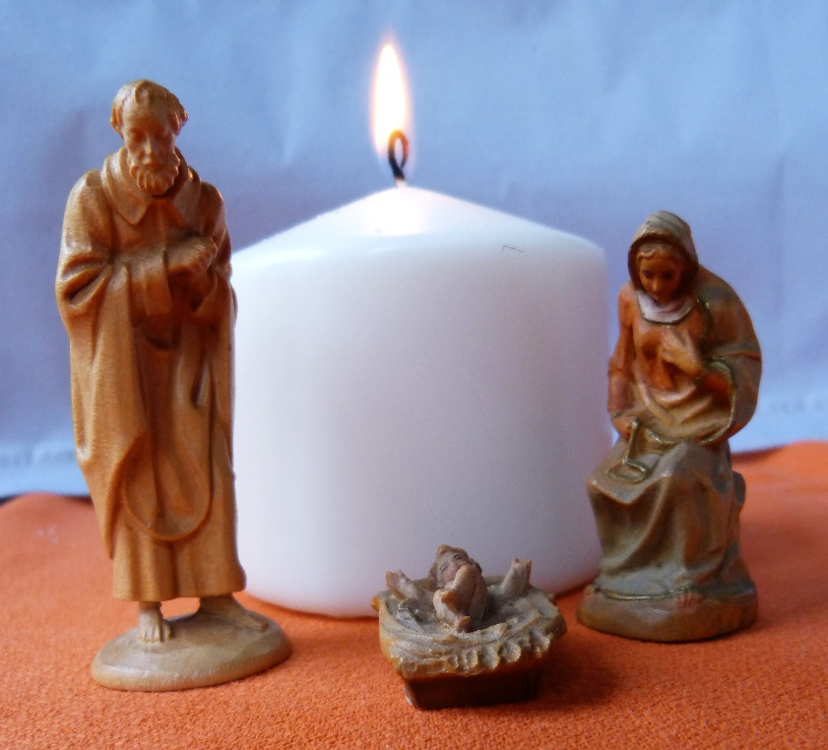
Have a very happy and peaceful Christmas
Back to grid

