Slide 1
Advent Calendar 2023
Birds of the Bible

Slide 2
The birds mentioned in the bible are not the only ones to be found in the Holy Land, and not all of those mentioned are included here.
Pick today’s date on the grid to see what today’s bird is.
When you have finished select ‘Back to Grid’ before you shut down, ready for tomorrow.

Slide 3
1
2
3
4
5
6
7
8
9
10
11
12
13
14
15
16
17
18
19
20
21
22
23
24

Slide 4
Barn Owl Leviticus 11:17
Barn Owls are one of four owl species native to the UK, and there are about 9,000 pairs of resident at the moment. They are to be found in most continents and are one of the world’s most popular owls. At the time of Moses they were known as the ‘Great Owl’. They fly at night in open country and farmland, but are often seen flying along roadside verges at dusk. Owls were listed as unclean, and therefore not to be eaten by the Children of Israel
BACK TO GRID

Slide 5
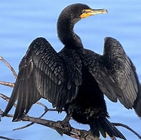
Back to grid
Cormorant
Leviticus 11:17; Deuteronomy 14:17
Another large bird listed as unclean, and not to be eaten. A diving bird that hunts fish, it lives in coastal areas and in recent times also on large rivers and lakes (you can often see some at Stanborough Lakes). Some can dive as deep as 45 metres (150 feet), and they are regularly seen holding their wings out to dry after a period of fishing

Slide 6
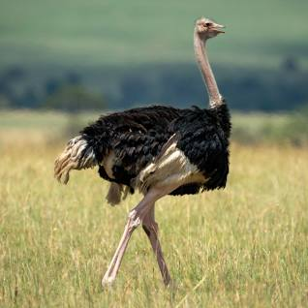
Ostrich
Lamentations 4:3 and elsewhere
Sometimes wrongly referred to in translations as an owl or a peacock, the ostrich is referred to in various passages in the Old Testament for the beauty of its plumes of feathers (probably as valued in ancient times as they were in Europe in more recent times), its swiftness as a runner, its reputed stupidity, and its habit of leaving its eggs on the surface to hatch by the sun’s heat
Back to grid

Slide 7
Back to grid
Raven
Genesis 8:7; Leviticus 11;15; 1 Kings 17:4-6
A bird of mountains and deserted places, larger than a crow, with a heavier and sharper beak. It was considered unclean because of its feeding on carrion and pecking the eyes from baby birds in their nests. And yet it was these unclean birds that were ordered by God to take food morning and night to Elijah when he was in exile in the wilderness by the River Jordan

Slide 8
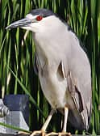
Back to grid
Heron
Leviticus 11:19
Herons can sometimes be seen at Stanborough Lakes, and there is a heronry at Lemsford. The “heron, after its kind” referred to in the list of unclean birds means all of the different types of heron found in the Holy Land. This one is a Night Heron. One was spotted at Capernaum on the northern shore of the Sea of Galilee. As its name suggests, it tends to hunt at night, resting in a bush or tree during the day. Occasionally these birds are seen in the UK, and a pair nested in Somerset in 2017

Slide 9
Back to grid
Quail
Exodus 16:11-13; Numbers 11:31
A bird considered to be clean, and therefore edible. Exodus tells of how they landed in the Israelite camp in the morning. In Spring enormous numbers migrate across the desert at night, flying low and land in the morning utterly exhausted. Then they can literally be slaughtered in their thousands. Interestingly the same word for them is used in both Hebrew and Arabic

Slide 10
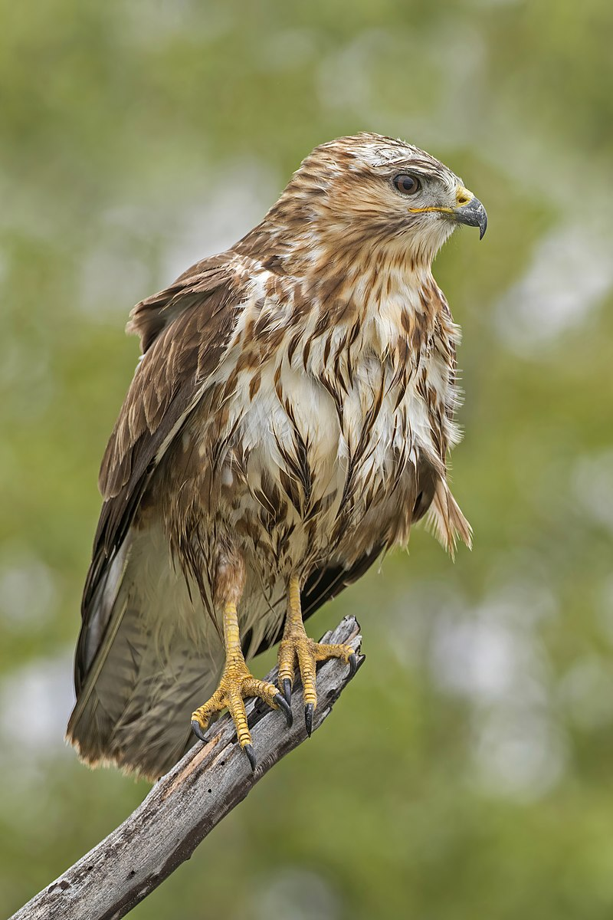
Back to grid
Buzzard
Leveticus 11:14; Deuteronomy 14:13; Isaiah 34:15
It is difficult to identify all of the birds of prey listed as ‘Unclean’ in the Old Testament, since names have changed both in Hebrew and in English over the centuries. The King James version refers to the Glede but modern translations refer to the Buzzard, of which there are 3 species in the Holy Land. Not so common in the WGC area as they used to be due to the increase in house building, Common Buzzards like this one can sometimes be seen in the Sherrardswood area

Slide 11
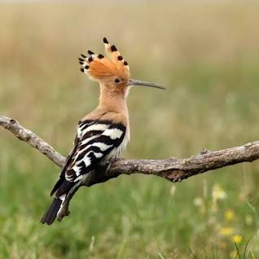
Back to grid
Hoopoe
Leviticus 11:19; Deuteronomy 14:18
A good example of a word’s meaning being lost in translation. The King James translation refers to the Lapwing, but experts agree that the Hoopoe (pronounced ‘hoopoo’) is intended, as the Hebrew, Syrian and Coptic words for this unclean bird are all the same, and it was worshipped by the ancient Egyptians. Both birds have a long feathery crest, but the Lapwing’s winter range doesn’t extend as far south, and the Hoopoe is only now beginning to be seen occasionally in Southern England with global warming. It was probably unknown in King James’ time, hence the mis-translation.

Slide 12
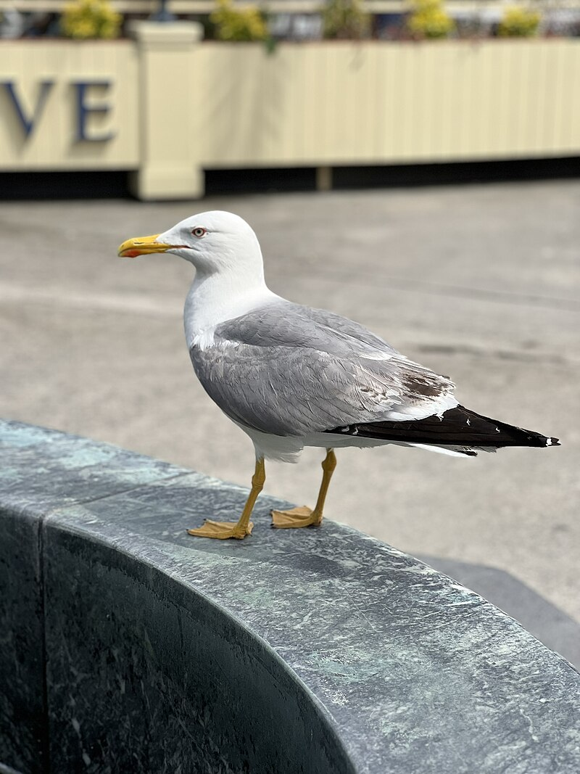
Seagull
Leviticus 11:16
Today the most common gulls to be found in the coastal areas around the two northern arms of the Red Sea and the south-eastern Mediterranean are the Mediterranean Gull (similar to our Black-Headed Gull) and the Yellow Legged Gull, shown here. If you think of the rubbish that gulls eat it is not surprising that they were considered to be unclean and therefore not to be eaten.
Back to grid

Slide 13
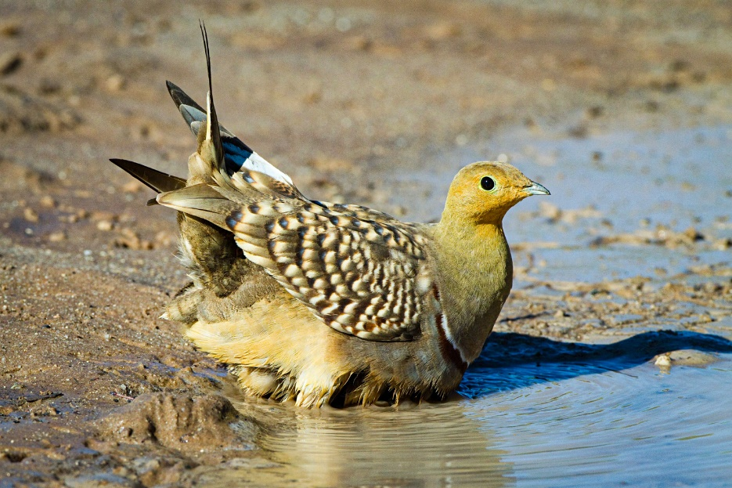
Partridge 1 Samuel 26:20; Jeremiah 17:11
There are two species of Partridge in the Holy Land and Sinai Peninsula, neither of which is like those in the UK. The Francolin lives in the plains and the various types of Sand Partridge and Sand Grouse, as their name suggests, prefer deserts and other arid places. Sand Grouse like this one have special feathers that soak up water to take back to their young
Back to grid

Slide 14
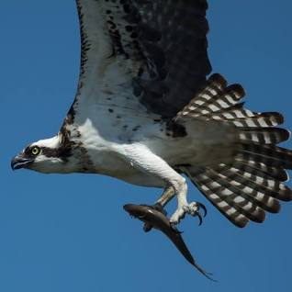
Osprey
Leviticus 11:13
Another in the list of Unclean Creatures. It is a large, fish-eating, bird with a wingspan of about 160cm and about 60cm long. The Holy Land and region around the north of the Red Sea are on the Eastern migration route from Europe. In the last 25 years or so ospreys have begun to breed again in certain parts of the UK, where their nests are protected and carefully monitored
Back to grid

Slide 15
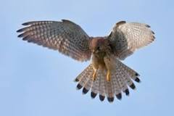
Hawk Leviticus 11:16; Deuteronomy 14:15; Job 39:26
This is a generic term used for all the smaller birds of prey common in the Holy Land, including the kestrel, merlin, hobby and sparrow hawk. The kestrel shown here is probably the hawk that is most often seen today, as it hovers above a field or over the central reservation of a motorway as it searches for voles
Back to grid

Slide 16
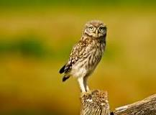
Little Owl
Levticus 11:17; Deuteronomy 14:16; Psalm 102:6
The Little Owl is very common about the villages, wells and old ruins of the Holy Land where it nests in holes in trees and buildings. It is the smallest owl (only 20cm high with a short tail) in the UK, where it was introduced in the 19th Century. It was the symbol of Ancient Athens, being the bird of Minerva, and was associated with wisdom.
Back to grid

Slide 17
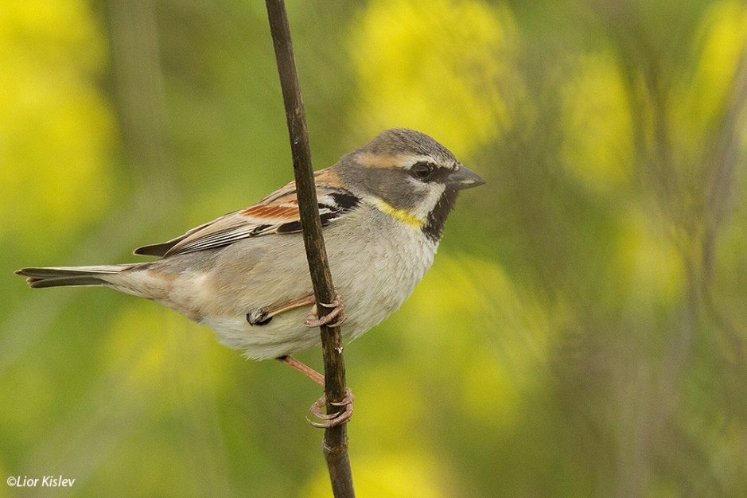
Sparrow
Psalm 84:3; Matthew 10: 29 & 31
Sparrows are so common across Europe that they are taken for granted, even though in the UK the breeding population of House Sparrows has declined to the point that they are on the Red List of Vulnerable Birds. Both the Psalmist and Jesus use the very common sparrow to show how far God’s Love extends for His creation. People may overlook sparrows – He doesn’t. The Hebrew word for ‘sparrow’ occurs over 40 times in the scriptures, and today there are four types of sparrow to be found in the Holy Land at some time during the year. This one is a Dead Sea Sparrow
Back to grid

Slide 18
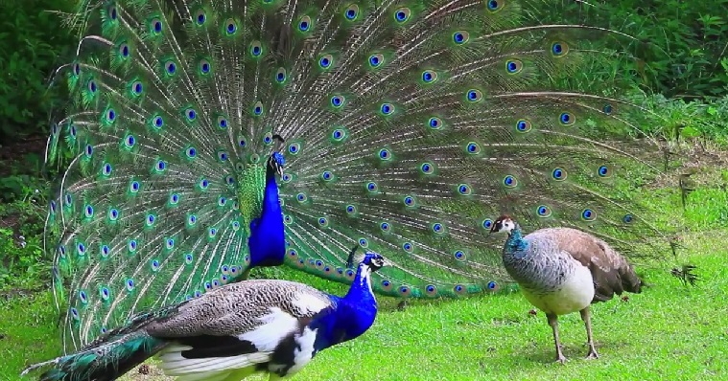
Peacock 1 Kings 10:22; 2 Chronicles 9:21
These two texts are virtually identical in modern translations. The Hebrew word for peacock (the female is a peahen) is the same as the Tamil word used in India, doubtless as a result of King Solomon’s trade with India in this and other commodities. The peacock is a sacred bird in Hindu culture, and the Ancient Greeks believed its flesh never decayed, even after death, so that it became a symbol of immortality. Early Christians adopted this, and it became an emblem of the Resurrection and Eternal Life of Christ in early artwork
Back to grid

Slide 19
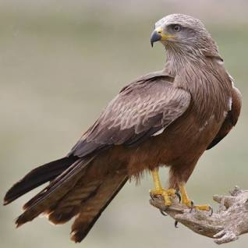
Kite Leviticus 11:14; Deuteronomy 14:13
Yet another bird of prey that was considered unclean. Given the Kite’s preference for eating carrion and finding food in rubbish (in WGC the red kites we see have been known to follow the food waste collecting trucks and pick out choice morsels to eat) it is not surprising.
The kites of the bible were probably black kites like this one – the Holy Land lies on their eastern migration route from Africa to Europe. As scavengers they were thought to have been protected by the villagers
Back to grid

Slide 20
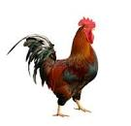
Cockerel Matthew 26:34 & 74
Anyone who has spent a night or two in the countryside will know the sound of a farmyard cockerel crowing to welcome the new day. Jesus warned St Peter that before the cock had crowed twice he would have denied knowing Jesus on three occasions. The prophecy came true, and St Peter was very upset
Back to grid

Slide 21
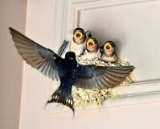
Swallow Psalm 84:3; Proverbs 26:2; Isaiah 38:14
The name ‘swallow’ is probably derived from the old English ‘swell’ meaning to swirl (a reference to the bird’s flight) or from the Norse word ‘swala’ meaning a cleft stick – referring to the bird’s forked tail. In ancient Greece swallows were associated with Aphrodite and brought good luck. Harming one could bring bad luck. In the early church the swallow symbolised Christ, who restored sight to the blind. And because the swallow takes so much care in nest building it also symbolised maternal love, and therefore the love of Our Lady for the Christ child, and for us too
Back to grid

Slide 22
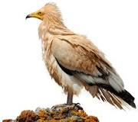
Back to grid
Vulture
Leviticus 11:13 & 18; Deuteronomy 12:14 & 17; Matthew 24:28
One of nature’s ways of removing dead bodies that would otherwise rot and the decay could result in disease – no wonder this bird was labelled ‘unclean’. Today in the city of Cairo the killing of a vulture is still forbidden. The ancient Egyptians worshipped the goddess Nekhbet, who took the form of a winged vulture and was responsible for the protection of pharaohs and women in childbirth. This picture is of an Egyptian vulture. It is one of the few bird species known to use tools. It uses smooth stones to open eggs and sticks to gather and roll wool to line its nest.

Slide 23
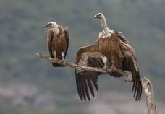
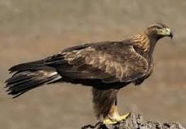
Back to grid
Eagle
Exodus 19:4; Isaiah 40:31; Ezekiel 1:10; Daniel 7:4; Revelation 4:7 & 12:14
It is difficult to determine what type of eagle the writers of these books were referring to, especially as Ezekiel, Daniel and St John the Divine were trying to describe what they had seen in visions. The Hebrew and Aramaic word nesher occurs 27 times in the bible and refers to the great griffon vulture which was common in Assyrian sculpture, but the early translators made a mistake using the word a’etos which is Greek for eagle. The griffon vulture (shown above) is huge, and can be as much as 110cm long with a wing span of up to 265cm. By comparison, our Golden Eagle (shown below) is a little smaller.
The eagle is the symbol of the fourth evangelist, St John.

Slide 24
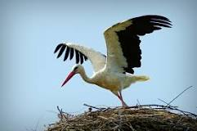
Stork Leviticus 11:19; Psalm 104:17; Jeremiah 8:7; Zeechariah 5:9
The Hebrew word for a stork is hasidah, meaning kindness, gentleness, faithfulness, and mercy, the characteristics attributed to God. There are two types of stork in the Holy Land: the white and the black stork. Only the white stork builds its nest on top of houses.
The migration of the stork, leaving in the summer, a season associated with fertility in ancient times and returning in the spring, nine months later led to the idea that it was the stork that brought babies
Back to grid

Slide 25
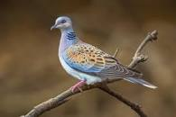
Turtledove Genesis 15:9; Leviticus 14:22; Jeremiah 8:7; Luke2:24
One of only two birds specified by God for sacrifice for those too poor to provide a lamb or kid. A summer visitor to Europe and the Holy Land, it winters south of the Sahara Desert, and its return each year was considered to be a sign of Spring.
Back to grid

Slide 26
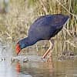
Waterhen Leviticus 11:18
The King James translation of the bible refers to the Swan in this text. However, swans are very rare in Egypt and the Holy Land, and modern translations refer to the waterhen. The Purple Waterhen, shown here, is a member of the Rail family of birds that live at the water’s edge, skulking about in the reeds, and would have been unknown to the translators of King James’ time.
Back to grid

Slide 27
Pigeon or Dove Genesis 15:9; Leviticus 14:22; Isaiah 38:14; Luke 2:24; John 1:32 and others
Not the feral pigeon that lives in our towns, but the Rock Dove or Rock Pigeon from which they have descended. The Hebrew word yonah may be translated as pigeon or dove. It is the only other bird specified by God for sacrifice. Two birds were to be sacrificed, one as a burnt offering, the other as a sin offering.
Over the years the dove has come to be generally accepted as a sign of peace. It is also the symbol for the Holy Spirit, as reported by John the Baptist after Jesus’ baptism in the River Jordan

Slide 28
Have a very happy and peaceful Christmas
Back to grid

