Slide 1
Welcome to the 2022 St Francis Advent Calendar. This year’s theme is ‘Animals of The Bible’. Not all of the animals referred to in The Bible have been selected – there are too many. You may wonder why there are no birds - they will be the subject of their own Advent Calendar another year. Some Bible references are given for each animal, so that you can look them up as well. To start, on the left select the slide number for the day then, on the toolbar above, select ‘Slide Show’ at the top, followed by ‘From Current Slide’ in the ‘Start Slide Show’ section on the top left. Now watch the curtains open to reveal the day’s animal.

Slide 2
1

Slide 3
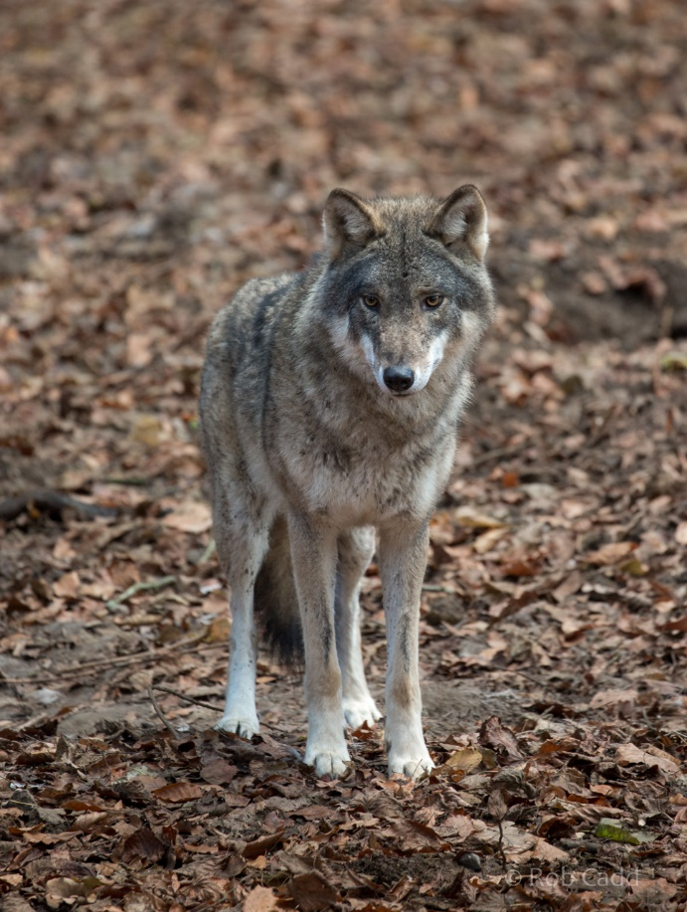
Isaiah 11:6, Matthew 7:15
To anyone who kept livestock through the ages the presence in the area of a wolf, or worse, a pack of wolves, was a big problem. In some parts of the world they still are, as television documentaries of wolves hunting bison, or musk ox, or moose in northern Canada show.
We all know the tale of Little Red Riding Hood. It is unlikely that this event actually happened, more likely it was originally a tale made up to frighten people into being careful. However, Jesus imagined wolves who pretended to be sheep in order to get among the flock and get themselves a meal. Not much different to those who carry out a scam today, really.
Isaiah, on the other hand, foresees a time of Peace, God’s Peace, when hunter and prey can live peaceably together.
Photo from Wikepedia

Slide 4
That was today’s animal. Shut down now with a right click on your mouse, then select ‘End Show’. Re-open tomorrow to see tomorrow’s animal. If you want to see that now, then left click on your mouse.

Slide 5
2

Slide 6
Judges 14:8, 1 Samuel 17:34-37, 1 Kings 13:24, Isaiah 11:6, 30:6, 65:25, Daniel 6:7, Ezekiel 1:10, 1 Peter 5:8, Revelation 4:7, 13:2
You don’t get lions in the Holy Land now, but clearly they were not uncommon in Old Testament times, as the stories of David the shepherd and Daniel in the lions den tell us.
Lions were used by the Romans in their amphitheatres – we have all heard about Christian martyrs being thrown to the lions. Although there was not thought to have been an amphitheatre in Jerusalem in Jesus time (a small one has been found dating back to the 2nd century) there was one in the Roman coastal town of Caesarea Maritime, and it is quite likely that Jesus would have been aware of them.
This lion is part of a pride that lives in Zambia

Slide 7
That was today’s animal. Shut down now with a right click on your mouse, then select ‘End Show’. Re-open tomorrow to see tomorrow’s animal. If you want to see that now, then left click on your mouse.

Slide 8
3

Slide 9
1 Samuel 17:34-37, 2 Kings 2:24, Isaiah 11:7, Daniel 7:5, Revelation 13:2
Like lions, brown bears used to live in the Holy Land, and were just as big a pest in preying on the villagers’ herds of sheep and goats, as David told King Saul.
Now it only survives in parts of Turkey, Iran and Iraq, although Syrian Brown Bear tracks were recorded in some mountains in Lebanon in 2004 and again in2011.
The Syrian brown bear is a rather small bear, usually very light brown, in parts straw-coloured, sometimes with a dark stripe running across the back. Its legs are often darker, and it is the only known bear to have white claws.
Facts & photo from Wikepedia

Slide 10
That was today’s animal. Shut down now with a right click on your mouse, then select ‘End Show’. Re-open tomorrow to see tomorrow’s animal. If you want to see that now, then left click on your mouse.

Slide 11
4

Slide 12
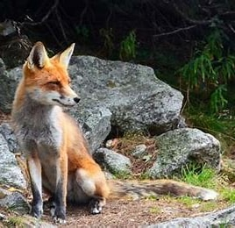
Judges 15:4, Nehemiah 4:3, Matthew 8:20, Luke 13:32
It is possible that references to foxes, particularly in The Old Testament, included jackals, which apparently were common in the Holy Land at that time. However, Jesus is clearly referring to the fox and its cunning when quoted by St Luke. This is not the same Herod of the Nativity story who was visited by the Wise Men, but a successor who clearly had a reputation for being a very crafty and cunning individual.
It seems that in Israel foxes have adapted to an urban life, just as they have in this country. They have been seen playing in the Temple area of Jerusalem.
Foxes are sometimes in the Parkway area of Welwyn Garden, and one is known to hunt the woodpigeons in the church gardens

Slide 13
That was today’s animal. Shut down now with a right click on your mouse, then select ‘End Show’. Re-open tomorrow to see tomorrow’s animal. If you want to see that now, then left click on your mouse.

Slide 14
5

Slide 15
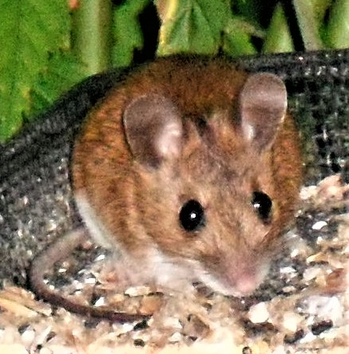
Leviticus 11:29, Isaiah 66:17, 1 Samuel 6:5
References to mice in The Bible are probably generic, covering all types of mice found in the area and other similar creatures as well, such as hamsters. The pet golden hamsters so beloved by children in this country are all descended from a family found in Israel or Palestine many years ago. The reference in 1 Samuel is thought to be to common field mice.
Although there is no mention of a mouse in the gospel stories, one can be reasonably certain that there would have been one, or even a family of mice, somewhere in the stable at the time of Jesus’ birth.
This particular mouse is a wood mouse.

Slide 16
That was today’s animal. Shut down now with a right click on your mouse, then select ‘End Show’. Re-open tomorrow to see tomorrow’s animal. If you want to see that now, then left click on your mouse.

Slide 17
6

Slide 18
Isaiah 11:6, Jeremiah 13:23, Daniel 7:6, Revelation 13:2
The leopard is another big cat that was once known in the Holy Land, as the visions of both Daniel and St John the Divine indicate.
They tend to be secretive, for their own protection. This one was seen out hunting in Zambia after dark, and had just crossed the road in front of a car. It has turned its head from the car headlights.

Slide 19
That was today’s animal. Shut down now with a right click on your mouse, then select ‘End Show’. Re-open tomorrow to see tomorrow’s animal. If you want to see that now, then left click on your mouse.

Slide 20
7

Slide 21
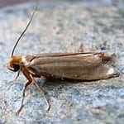
Isaiah 50:9, 51:8, Matthew 6:19
The clothes moth is the only one of its species mentioned in the Bible. With clothes and all other fabrics being made from either wool or linen everyone must have been well aware from an early age of the destructive power of the moth larvae if eggs were laid in a clothes store. Jesus puts the destructive effect in the same class as that of rust on metal – something else everyone would know about.
Perhaps this is a situation where the poor were actually the ones who were better off. With fewer clothes and no luxury fabrics there was less for the moth to damage. And no-one took any notice if a poor person had a hole in their clothes. Jesus was much more interested in the person themselves.

Slide 22
That was today’s animal. Shut down now and re-open tomorrow to see tomorrow’s animal. If you want to see it now then left click on your mouse

Slide 23
8

Slide 24
Leviticus 11:, Deuteronomy 14:8, Proverbs 11:22, Isaiah 65:4, 66:3, Matthew 7:6, 8:31, 2 Peter 2:22
The Laws of Moses do not allow the descendants of Abraham (Jews and Muslims) to eat pigs – although they have a cleft hoof (or trotter) they don’t chew the cud and are therefore considered unclean. Given the way they would have been kept in biblical times this is not surprising. Indeed, the way they were kept in this country until recent times was no better, and they are still kept in poor conditions in many developing countries. Other religions have similar food rules.
However, this did not stop people of Jesus time keeping them. The Romans loved roast pork, so it was a good source of income.
These pigs were spotted at Tewinbury Farm.

Slide 25
That was today’s animal. Shut down now with a right click on your mouse, then select ‘End Show’. Re-open tomorrow to see tomorrow’s animal. If you want to see that now, then left click on your mouse.

Slide 26
9

Slide 27
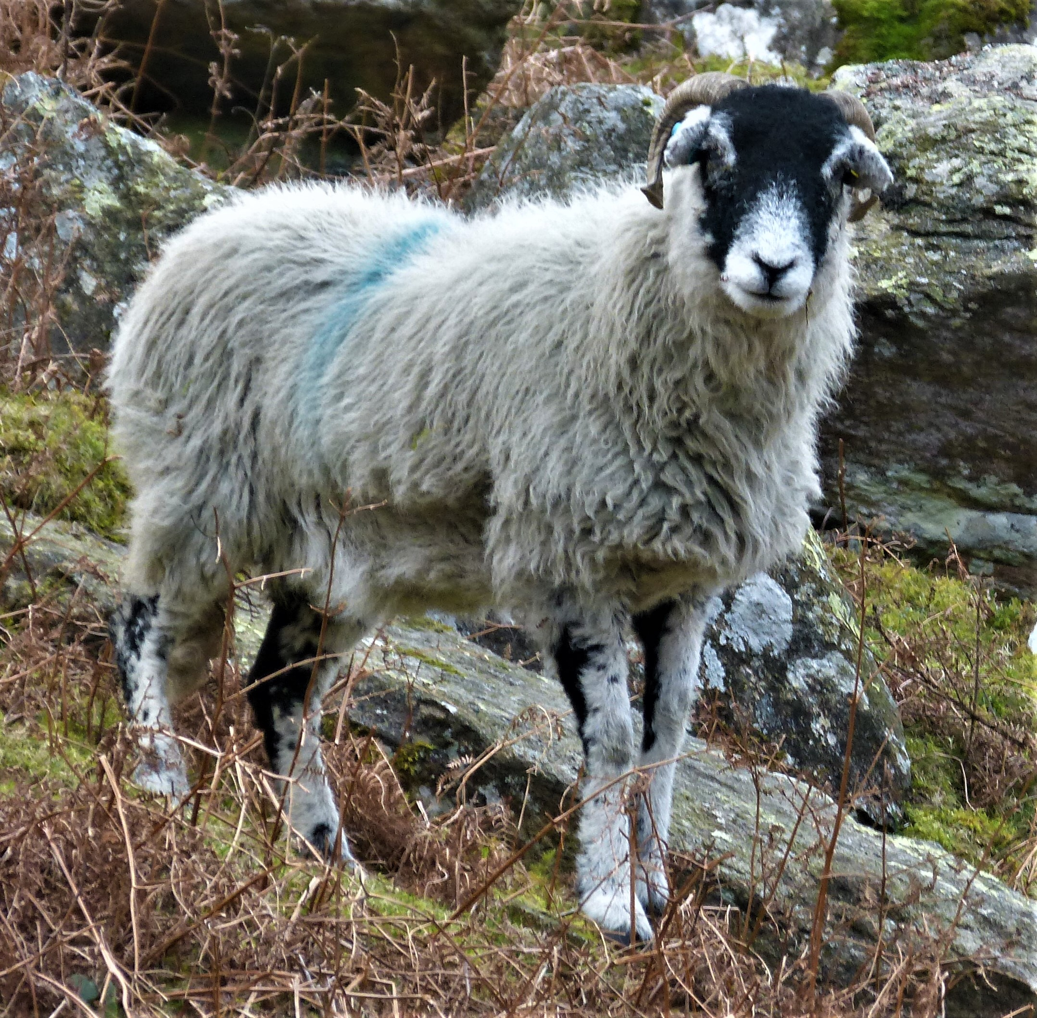
Exodus 12:5, 1 Samuel 17:34, Matthew 25:33, Luke 15:4, John 10:7
We all know about the shepherds whom the angels told about the birth of Jesus. It was not a very pleasant job, out all night making sure the sheep were safe from predators, having to climb into rocky holes looking for lost sheep, and then getting them out, providing help at lambing time. No wonder everyone else looked down on them. And yet these were the first people to be told of the birth of the Saviour.
Jesus compared Himself to a good shepherd, and said He had come to look for the lost sheep of Israel. Although it lives in the hills, this sheep is definitely not lost – it knows exactly where it is and carries its owner’s blue mark. A bit like the cross made on us at Baptism.

Slide 28
That was today’s animal. Shut down now with a right click on your mouse, then select ‘End Show’. Re-open tomorrow to see tomorrow’s animal. If you want to see that now, then left click on your mouse.

Slide 29
10

Slide 30
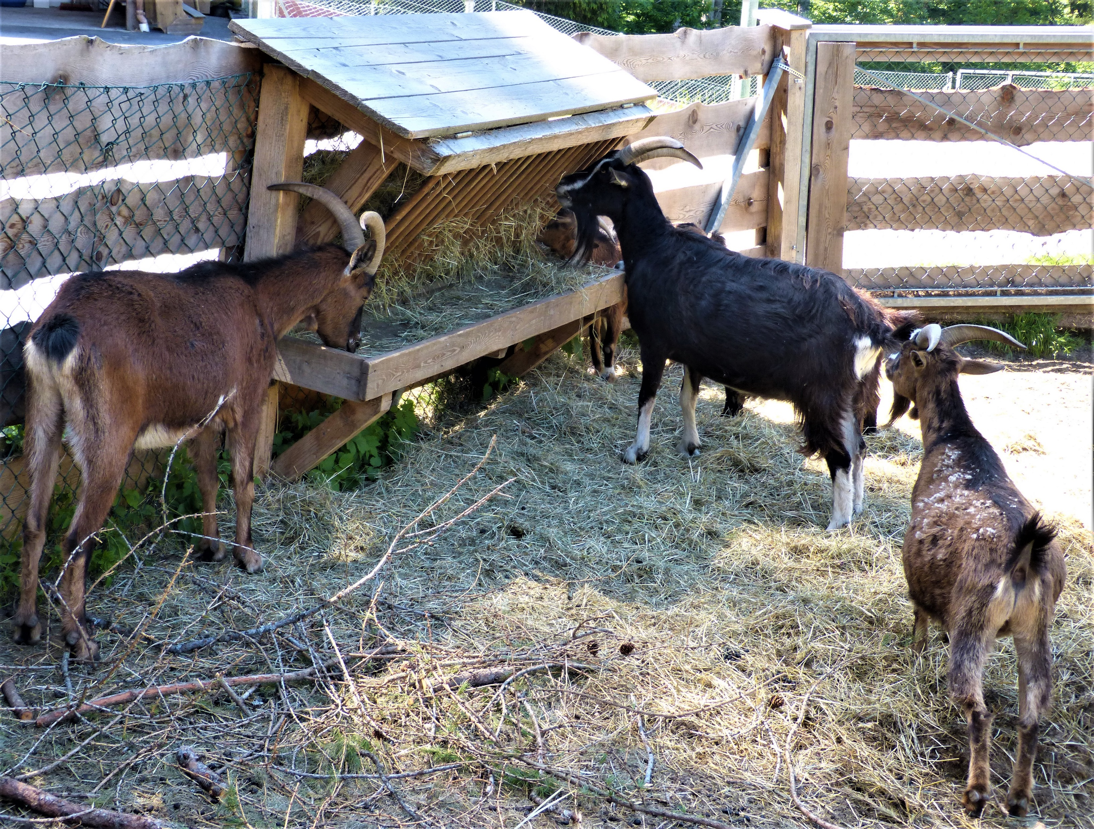
Leviticus 16, Deuteronomy 14:5, Job 39:1, Proverbs 30:31, Matthew 25:32-33
Like sheep, goats were kept for their milk, meat and skins. They still are. The Law of Moses identified them as ‘Clean’ animals. Wild goats could also be hunted for food.
Jesus said that those who were worthy to enter the Kingdom and those who weren’t would be separated just as a shepherd separates sheep and goats. Of course, everyone in the villages would have understood what He was talking about. They would also have been aware of the practice of identifying the scapegoat, as described in the Book of Leviticus. This is a practice still carried out in the villages of some poorer countries, where each year a goat is selected to carry the sins of the village and be driven out into the wild, where it will become prey for some carnivore.
These goats are typical of those found in the Alps.

Slide 31
That was today’s animal. Shut down now with a right click on your mouse, then select ‘End Show’. Re-open tomorrow to see tomorrow’s animal. If you want to see that now, then left click on your mouse.

Slide 32
11

Slide 33
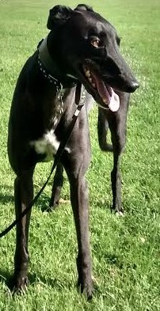
Proverbs 30:31
The greyhound is the only animal in the Bible that is referred to by its breed. Solomon, who wrote The Proverbs, is thought to have lived about 1000 years before the birth of Jesus, so clearly the greyhound is a very old breed.
As the name suggests, it was bred for hunting, and has been a favourite of royalty and the upper classes for centuries. It is very fast over a short distance, hunting by sight, not by scent, and can see small animals like hares, rabbits and squirrels a long way off.

Slide 34
That was today’s animal. Shut down now with a right click on your mouse, then select ‘End Show’. Re-open tomorrow to see tomorrow’s animal. If you want to see that now, then left click on your mouse.

Slide 35
12

Slide 36
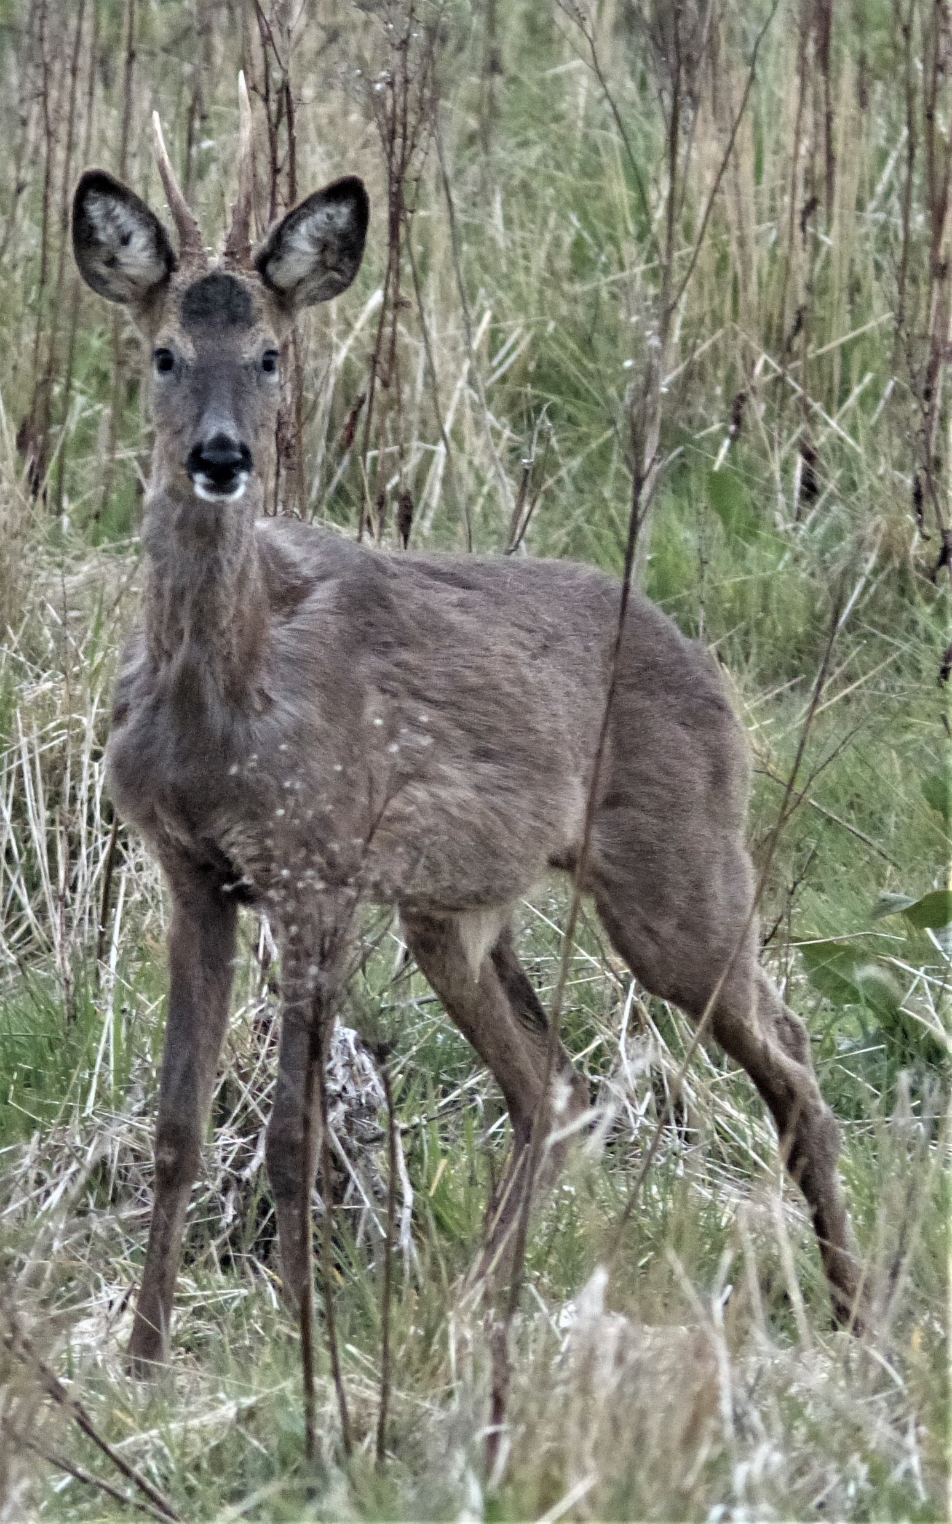
Deuteronomy 14:5
The roe deer is one of the animals specifically identified in the Law of Moses as being suitable for the Jews to eat. It has cloven hooves and chews the cud. This one was spotted in Northumberland. It is aware that the photographer is there, but uncertain of exactly where, because he is partially hidden and so does not appear to be a danger. Note that this photo was taken in late autumn or early winter and the deer’s longer fur coat can be seen.

Slide 37
That was today’s animal. Shut down now with a right click on your mouse, then select ‘End Show’. Re-open tomorrow to see tomorrow’s animal. If you want to see that now, then left click on your mouse.

Slide 38
13

Slide 39
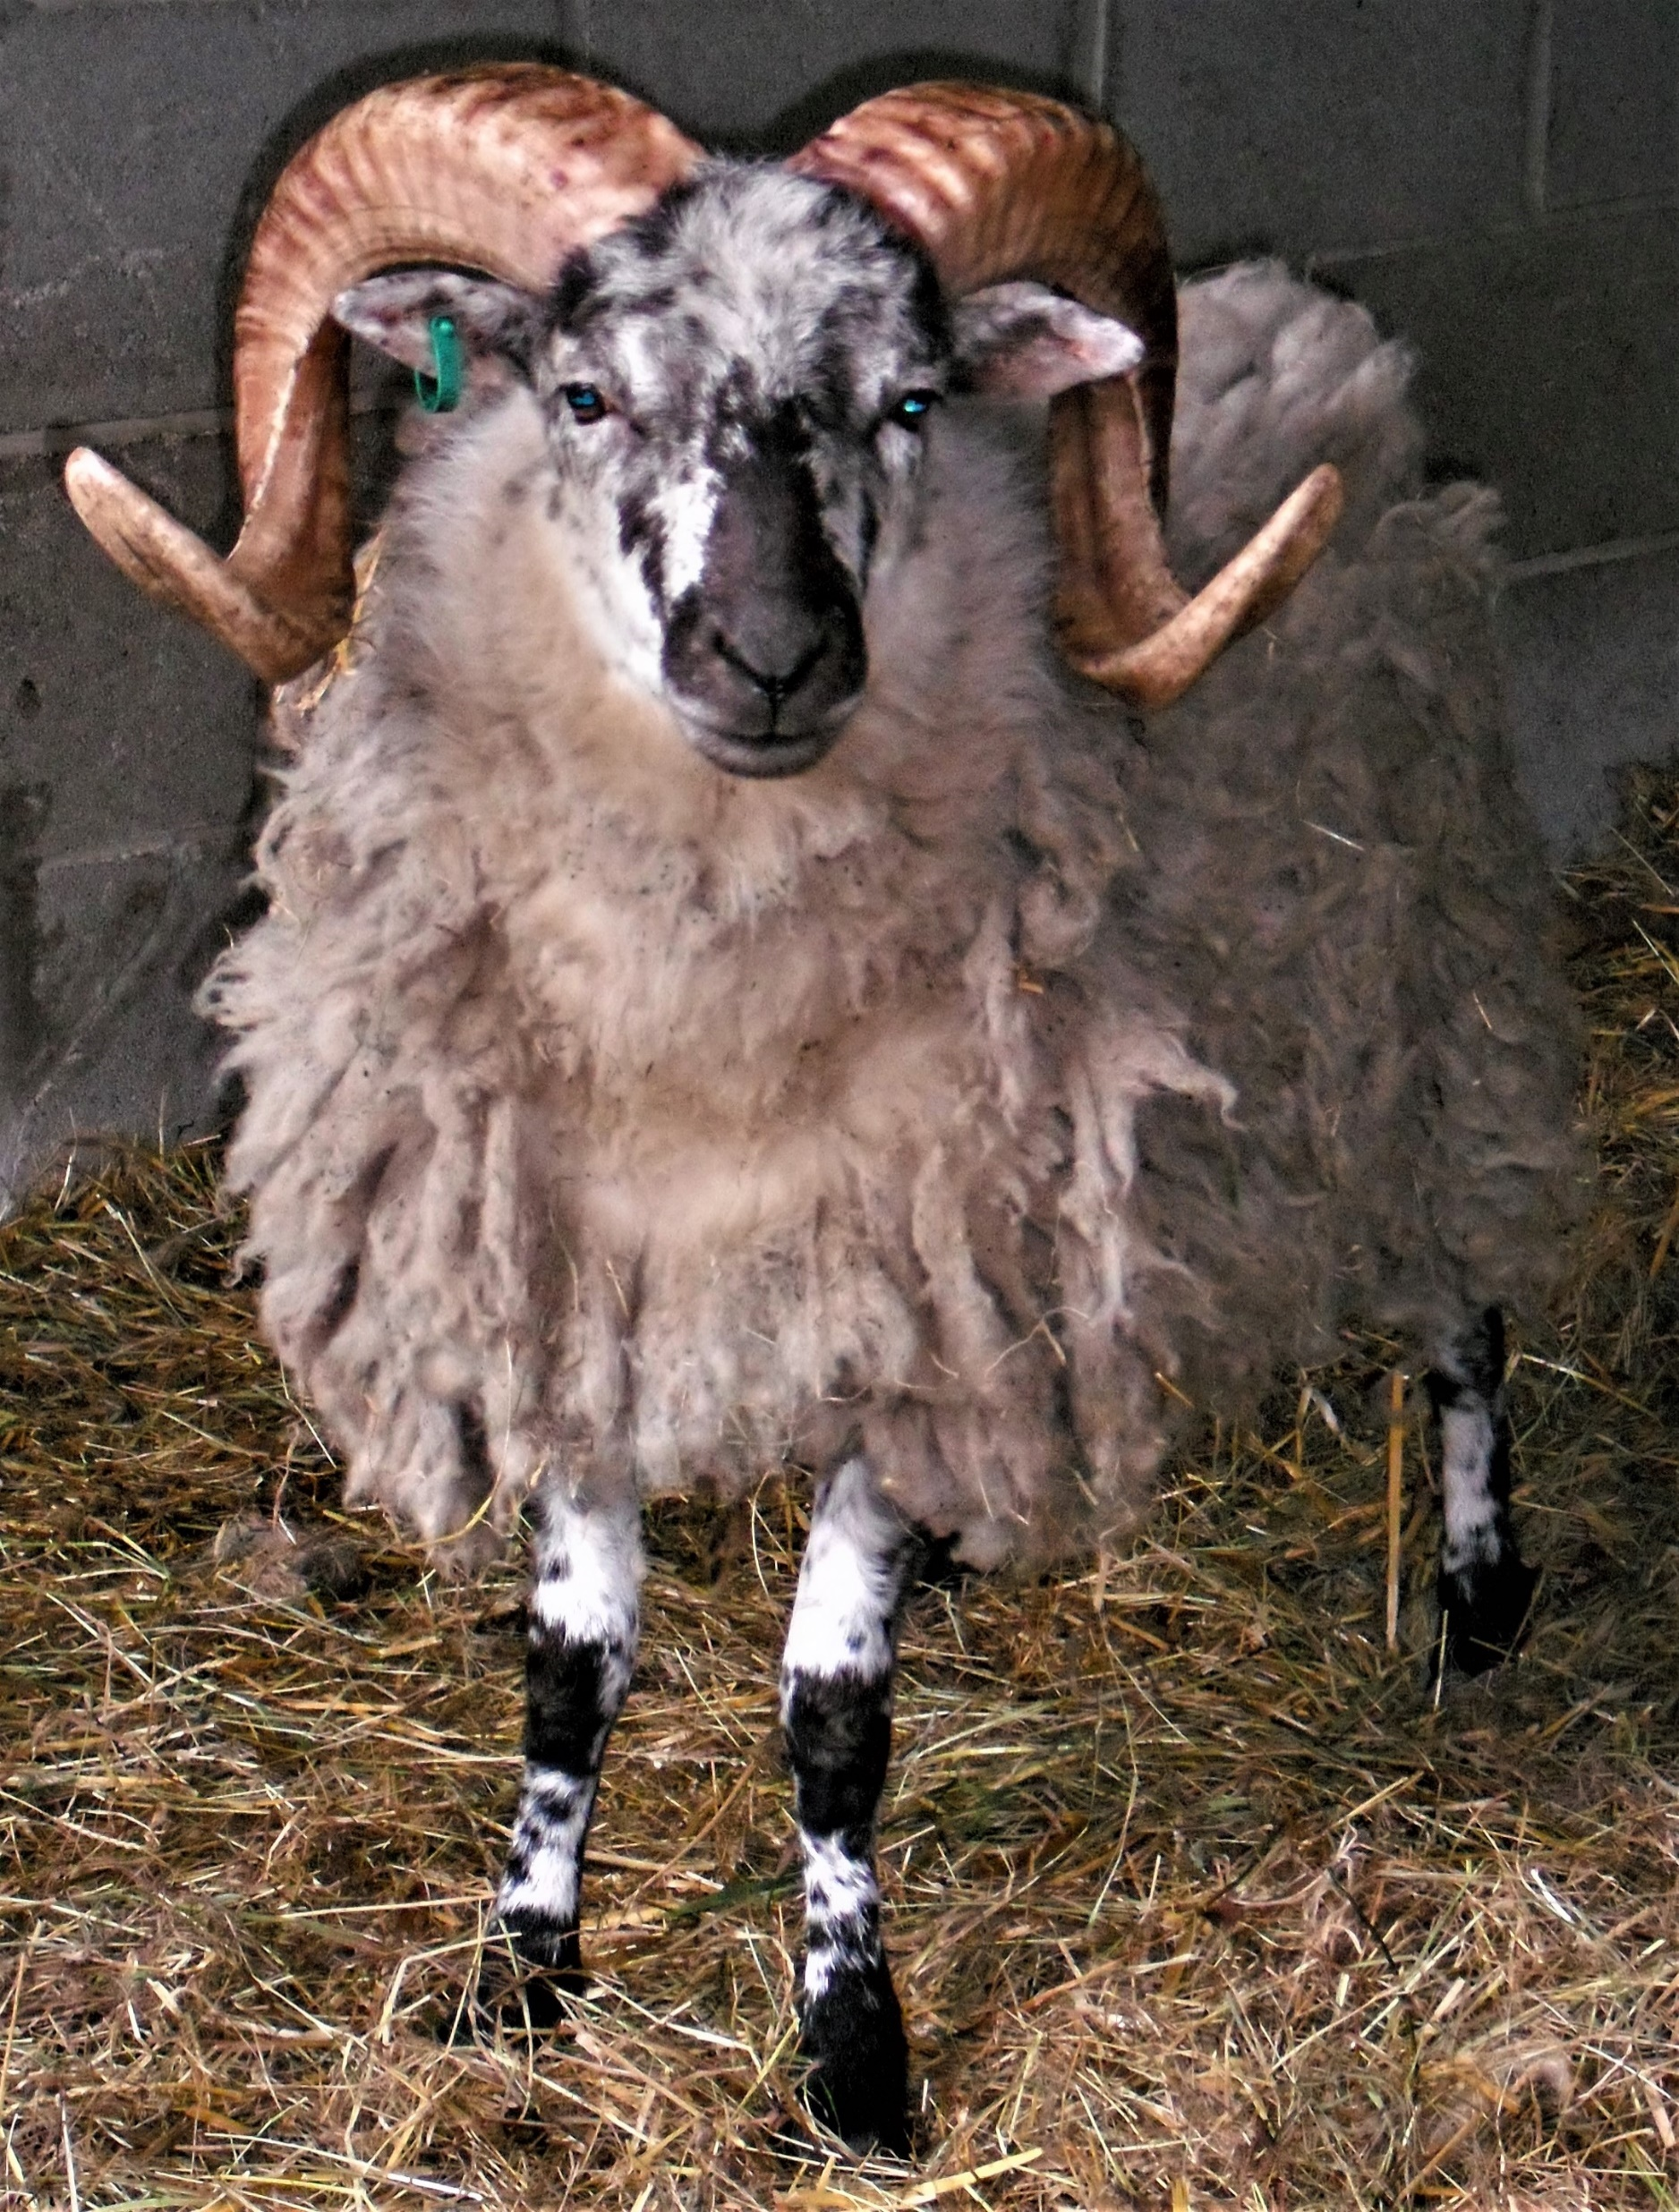
Genesis 15:9, 22:13, Exodus 25:5,
When God stopped Abraham from sacrificing Isaac there was a ram nearby caught by its horns in a thicket, and Abraham sacrificed that instead. Horns like these perhaps?

Slide 40
That was today’s animal. Shut down now with a right click on your mouse, then select ‘End Show’. Re-open tomorrow to see tomorrow’s animal. If you want to see that now, then left click on your mouse.

Slide 41
14

Slide 42
Numbers 18:17, 19:1-10, Isaiah 11:7, Daniel 4:25, Luke 14:5
The cow was just as important an animal in biblical times as it is today, and for the same reason. It was the source of milk, butter and cheese, although those who were not so well off kept goats. The colour of cows in ancient times is uncertain, although in the book of Numbers we learn that the children of Israel were commanded to sacrifice a “spotless red heifer” to God (note that the version in the Quran refers to a yellow heifer, so clearly there was some confusion as to the colour when the story was eventually written down).
This cow is typical of those found in the Alps – a very hardy breed.

Slide 43
That was today’s animal. Shut down now with a right click on your mouse, then select ‘End Show’. Re-open tomorrow to see tomorrow’s animal. If you want to see that now, then left click on your mouse.

Slide 44
15

Slide 45
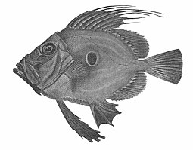
Exodus 7:18, Matthew 14:17, 17:27, Like 24:42, John 21:9
In November 2022 archaeologists announced that the remnants of a meal of cooked fish had been found at a site near the River Jordan used by early hunter-gatherers, and it had been dated to be about 780,000 years old. The remains were of a big carp, almost 2 metres long, and showed that it was slow-cooked, not just grilled, on a hot fire. It is the earliest evidence so far of food being cooked.
The Bible tells us that fish was common food in Jesus’ time, and several of the disciples were fishermen by trade.
In some countries this fish (a type of tilapia which in the UK is called a John Dory) is called the St Peter’s Fish, because of the black ‘Thumb Print’ on its side which, legend says, is where St Peter pulled it out of the water.
Photo from Wikepedia

Slide 46
That was today’s animal. Shut down now with a right click on your mouse, then select ‘End Show’. Re-open tomorrow to see tomorrow’s animal. If you want to see that now, then left click on your mouse.

Slide 47
16

Slide 48
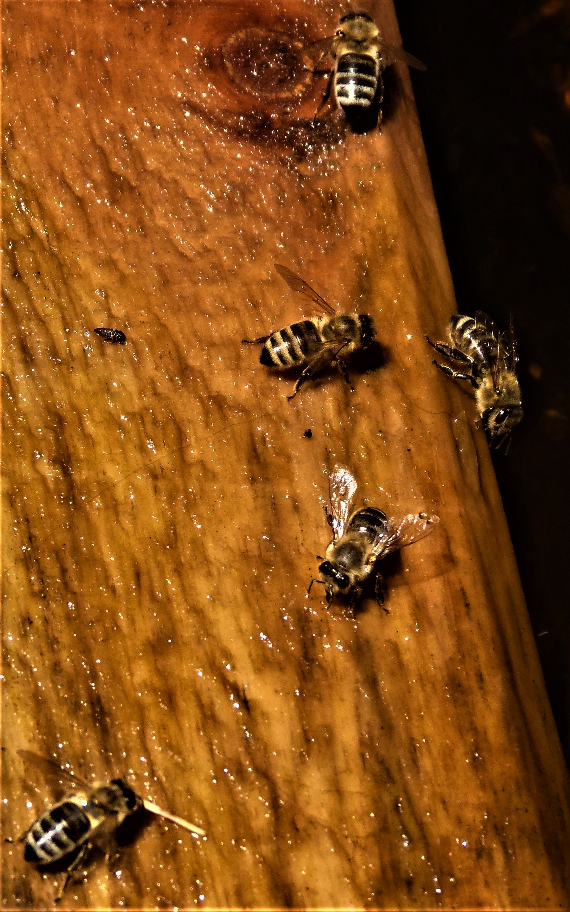
Judges 14:8
Honey bees, both wild and those kept in hives, have always been plentiful in the Holy Land. God promised Moses that the Israelites would settle in a “land flowing in milk and honey”. The climate is dry, there is an abundance of aromatic flowers of great variety. The nature of the rocks and existence of hollow trees provide ideal sites for wild bees to build a nest. What more could they want? Consequently honey (which is often mentioned in both Old and New Testaments) became a major export item.
These honey bees have found a water source from which to drink.

Slide 49
That was today’s animal. Shut down now with a right click on your mouse, then select ‘End Show’. Re-open tomorrow to see tomorrow’s animal. If you want to see that now, then left click on your mouse.

Slide 50
17

Slide 51
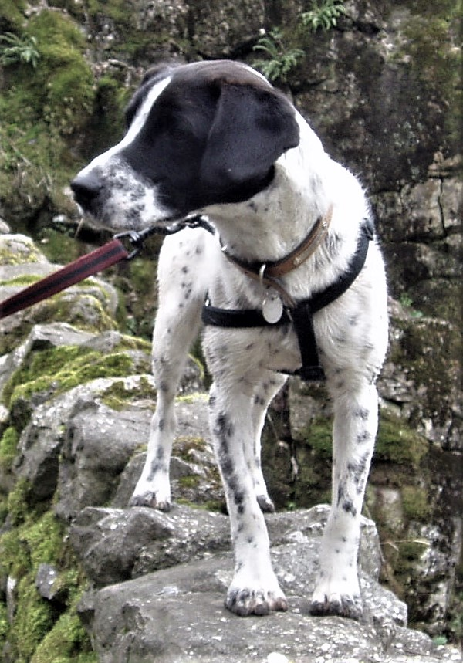
Judges 7:5, 1 Kings 21:23-24, Ecclesiastes 9:4, Matthew 15:26-27, Luke 16:21, 2 Peter 2:22, Revelation 22:15
Most dogs in Jesus’ time lived as a pack, scavenging around their town or village. In many countries dogs still do. They would not recognise the life that “man’s best friend” leads. Exceptions were probably those trained for a particular purpose such as a sheepdog, guard dog or hunting dog. That is probably why those of dubious reputation or unacceptable behaviour were likened to dogs.
This dog was found abandoned as a puppy and scavenging for food. He was rescued, and found a happy home.

Slide 52
That was today’s animal. Shut down now with a right click on your mouse, then select ‘End Show’. Re-open tomorrow to see tomorrow’s animal. If you want to see that now, then left click on your mouse.

Slide 53
18

Slide 54
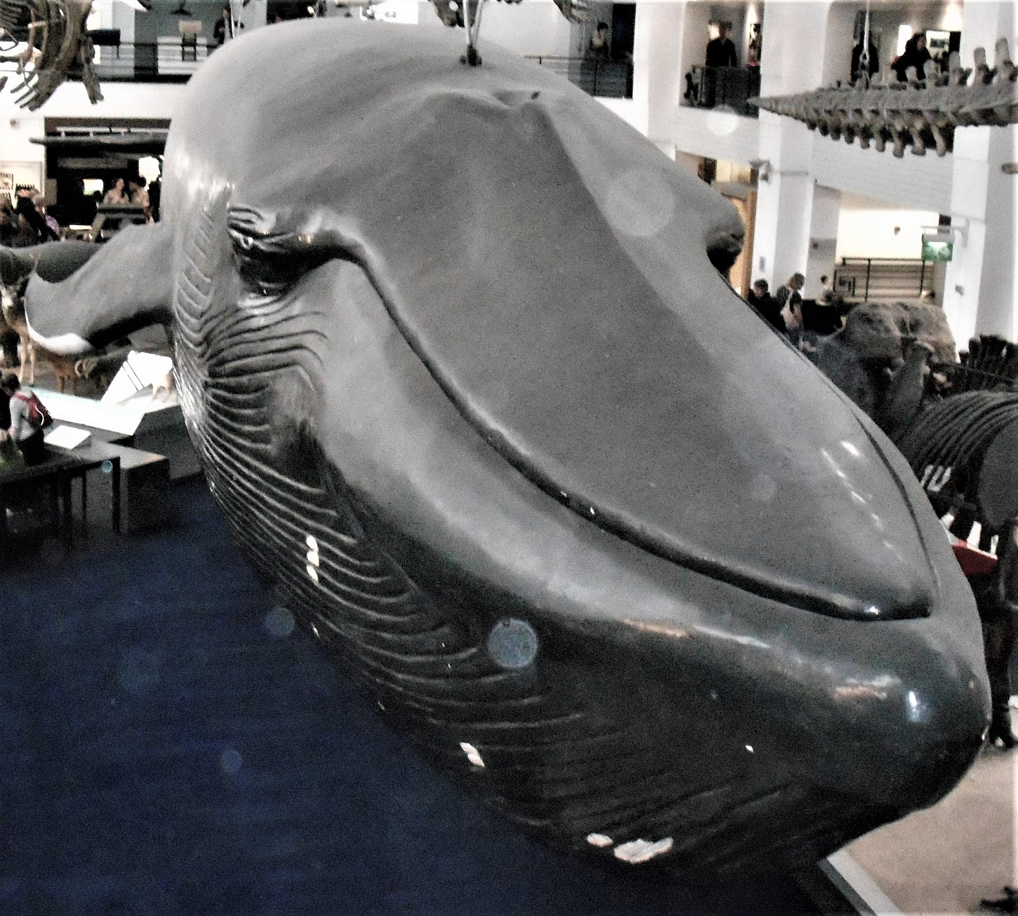
Jonah1:17
The prophet Jonah was, so the story tells us, swallowed by a great fish, or as legend has it, a whale. This model of a blue whale, the largest animal on the planet, hangs in the Natural History Museum in London.
It is thought that there may have been large whales in the Mediterranean at the time of Jonah, but no-one really knows.

Slide 55
That was today’s animal. Shut down now with a right click on your mouse, then select ‘End Show’. Re-open tomorrow to see tomorrow’s animal. If you want to see that now, then left click on your mouse.

Slide 56
19

Slide 57
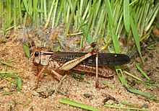
Exodus 10:4, Leviticus 11:22, Joel 1:4, Matthew 3:4, Revelation 9:3
Locusts are a type of grasshopper that have entered a migratory phase of their life. They gather in vast numbers, and when they fly the swarms can be so thick that they block out the sun. They are ravenous herbivores and when a swarm lands somewhere it can strip a field very quickly.
In parts of Africa when a swarm flies through a village people catch them using something like an old-fashioned butterfly net. They are considered good to eat when fried – a source of protein.
John the Baptist is recorded as having lived in the desert areas around the River Jordan by feeding on locusts and wild honey.
Photo from Wikepedia

Slide 58
That was today’s animal. Shut down now with a right click on your mouse, then select ‘End Show’. Re-open tomorrow to see tomorrow’s animal. If you want to see that now, then left click on your mouse.

Slide 59
20

Slide 60
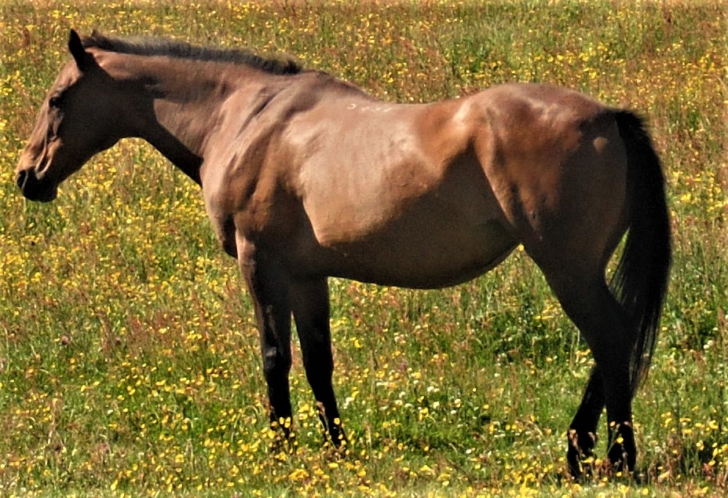
1 Kings 4:26, 2 kings 2:11, Revelation 6:2-8, 19:14
Horses only seem to be mentioned in the Bible in connection with war, either used by cavalry or for pulling war chariots. Neither were really suited to war in the hilly areas of Palestine. They were much more useful in the Egyptian deserts or the great plains.
Kings David and Solomon are thought to have been the first to establish cavalry and horse-drawn chariot forces for Israel.
Jesus would have been used to the horses of the Roman Army, and the Romans raced chariots as well. It is thought possible that one of the Wise Men came on a horse – if, as legend has it, he came from Africa rather than from Asia.

Slide 61
That was today’s animal. Shut down now with a right click on your mouse, then select ‘End Show’. Re-open tomorrow to see tomorrow’s animal. If you want to see that now, then left click on your mouse.

Slide 62
21

Slide 63
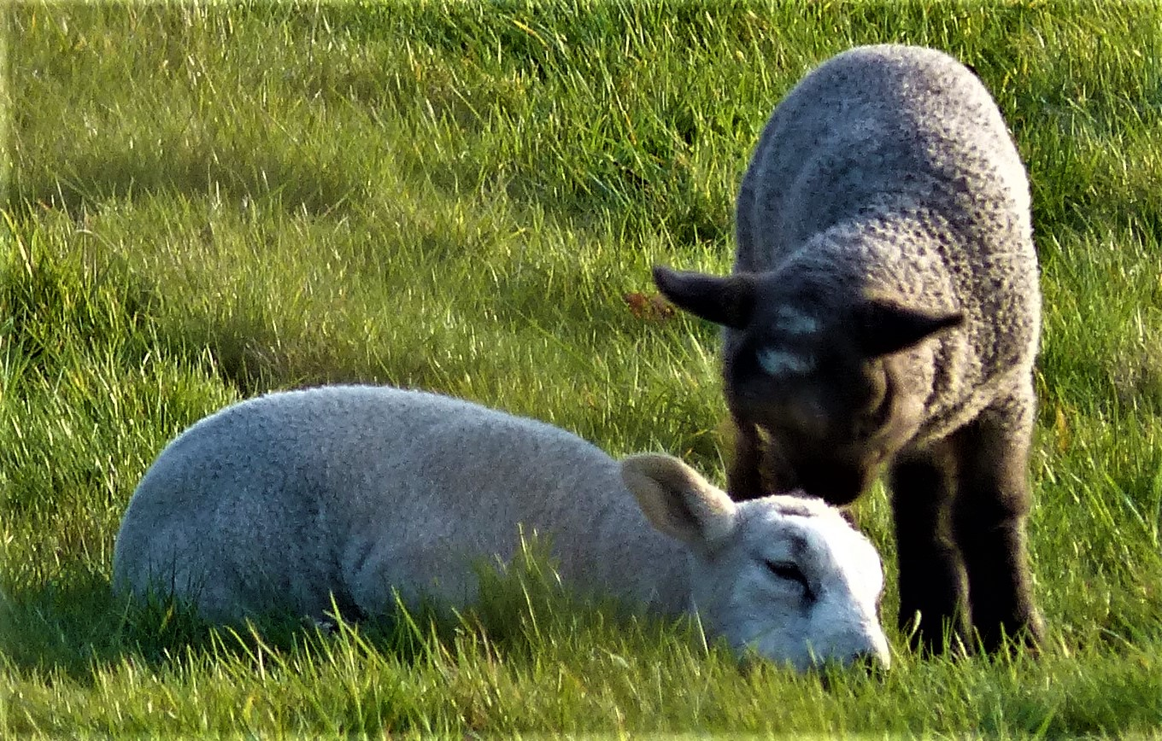
Genesis 4:2, 1 Samuel 17:34, John 2:29, Acts 9:32
Lambs – a joyful sign of spring, although you can also get autumn lambs.
John the Baptist called Jesus the Lamb of God, in comparison with the sacrificial lamb of the Law of Moses. It is a name we use today during the Communion Service.

Slide 64
That was today’s animal. Shut down now with a right click on your mouse, then select ‘End Show’. Re-open tomorrow to see tomorrow’s animal. If you want to see that now, then left click on your mouse.

Slide 65
22

Slide 66
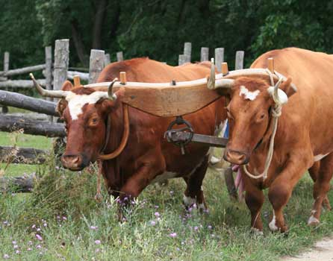
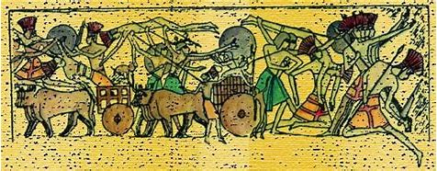
Exodus 21:28, 22:1, 23:4, Leviticus 17:3, Deuteronomy5:14, 22:1, 25:4, 1 Samuel 11:7, 2 Samuel 6:6, 1 Kings 19:20-21, Job 40:15, Isaiah 1:3, Ezekiel 1:10
Not surprisingly, the Laws of Moses included lots of regulations about oxen and how they should be treated – they were very much the beast of heavy burden and the work-horse of the day. They pulled heavy carts and ploughs, worked the threshing floor and much else that needed brute force. There are even ancient pictures of them pulling what look like chariots, but whether this is for war or hunting it is hard to tell.
An ox is more commonly called a bullock in the UK today, and although we don’t use them now, ox carts were common in the villages of the Alps as recently as the mid-fifties.
Tradition says that there was at least one ox in the stable with the donkey when Jesus was born. It is quite likely, although the Bible doesn’t mention it.
Photos from Wikepedia

Slide 67
That was today’s animal. Shut down now with a right click on your mouse, then select ‘End Show’. Re-open tomorrow to see tomorrow’s animal. If you want to see that now, then left click on your mouse.

Slide 68
23

Slide 69
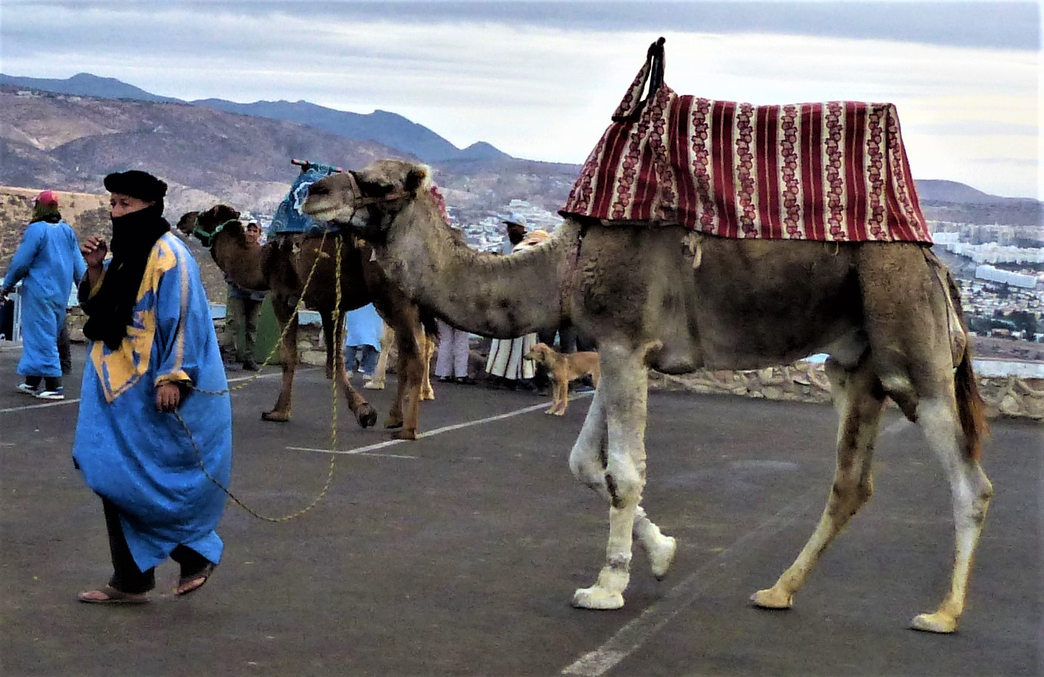
Genesis 24:10, Leviticus 11:4, Isaiah 30:6, Matthew 3:4, 19:24, 23:24
The camel was the means of transport, both for riding and for carrying great loads, for those who were well off in the Middle East until the invention of the car and the lorry. It was also used for cavalry as recently as the First World War. Although the Bible does not say so it has always been assumed that the Wise Men travelled by camel.
This camel gives rides to tourists in Agadir, Morocco. The mountains in the background are the western end of the Atlas Mountains

Slide 70
That was today’s animal. Shut down now with a right click on your mouse, then select ‘End Show’. Re-open tomorrow to see tomorrow’s animal. If you want to see that now, then left click on your mouse.

Slide 71
24

Slide 72
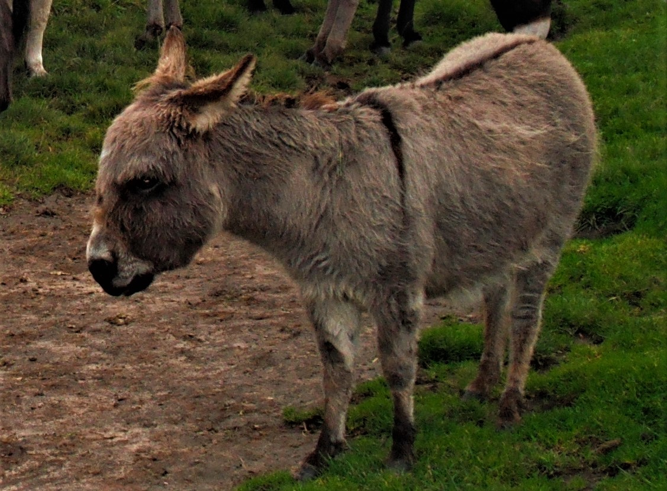
Numbers 22:21-41, Isaiah 1:3, 30:6, Matthew 21:2-7, Mark 11:2-7, Luke 19:30-35, John 12:14-15
Traditionally Joseph and Mary travelled with a donkey to carry their things (and doubtless Mary as well when she found walking hard work) although there is no mention of it in the gospels. Donkeys were, and in poorer countries still are, the beasts of burden for the masses. They are not always looked after very well, and this one certainly looks fed up. Jesus chose a donkey for His triumphal ride into Jerusalem on the first Palm Sunday – an act which is now celebrated every year in Jerusalem with a big procession that takes an hour to pass. Legend has it that in memory of that ride every donkey in the world carries a cross on its back, and this one’s cross is very clear to see.

Slide 73
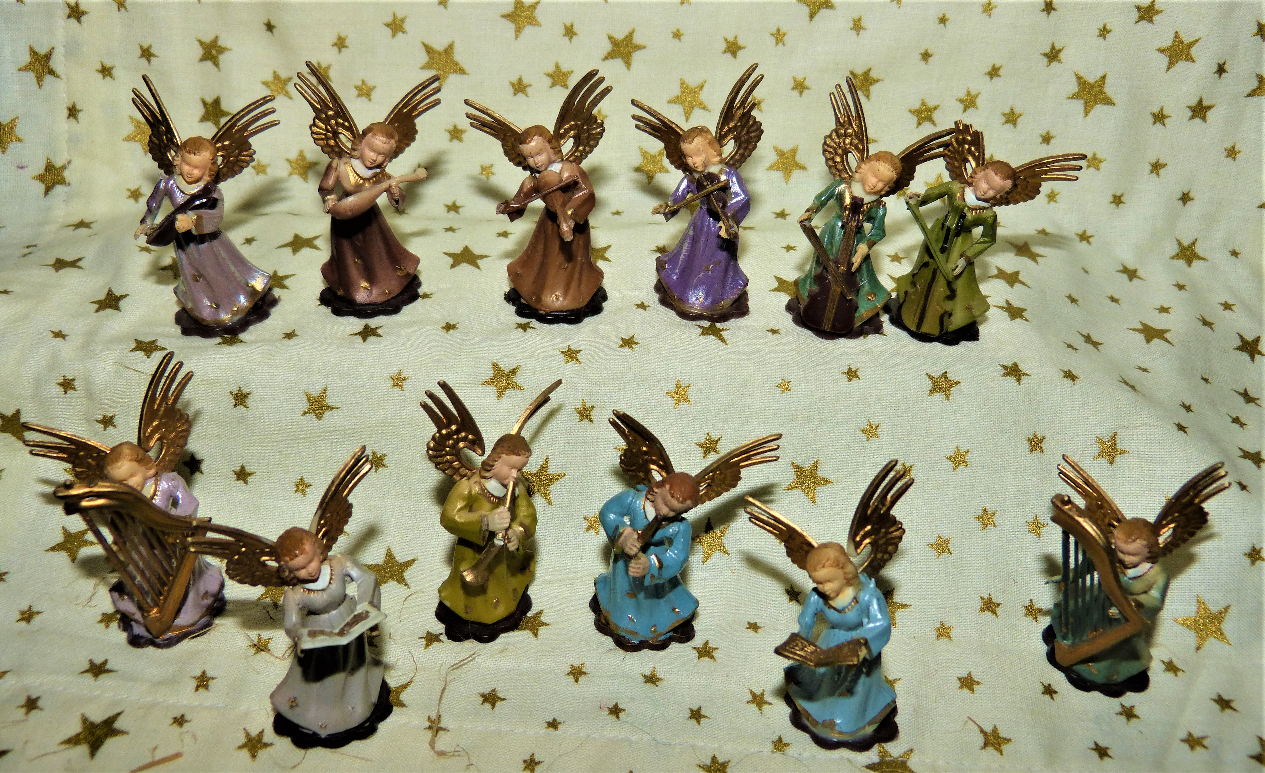
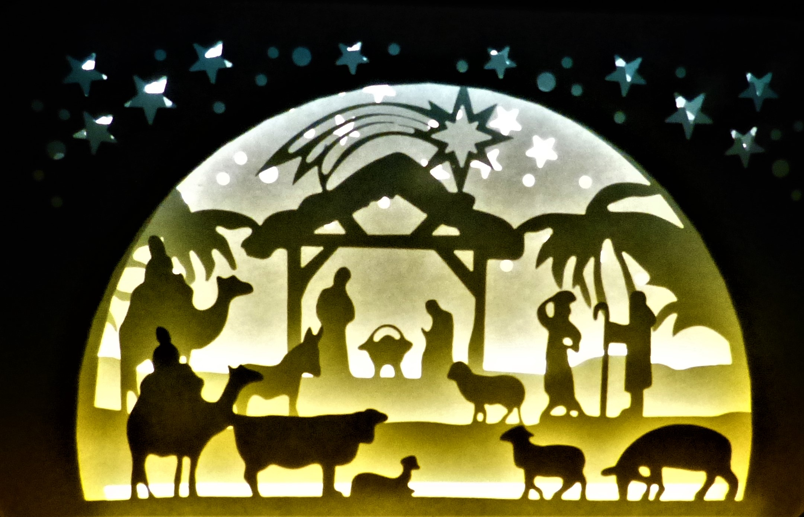
That was today’s animal, and the last on this Advent Calendar, because today is Christmas Eve, which means that tomorrow is Christmas Day – the day when we celebrate the birth of Jesus. So Happy birthday, Jesus, and a Very Happy Christmas to you too.

